Slide 1
Team 5 – Never Give Up N.G.U
E-LEARNING
Study and work right from your home
Website to support learning and working, connecting between students and businesses online
Read more

Slide 2
Overview
Flow Chart
Story Board
Review

Slide 3
Overview

Slide 4

Demand
Jobs
Teaching
Book
Studying

Slide 5
We Create
Quality Professional
E-Learning Platform
E
-learning website design makes many changes in the approach to knowledge and practice of both learners and instructors. You don't know since when, but the web and the Internet have changed a lot in terms of how you work and your concept.
General introduction
Friendly
Mainly on how to make your services known to many members. Coordinate with standard SEO technology and good communication plan
Create UX / UI designs to increase user experience, make them feel comfortable and satisfied when finding information on the website.
Web-app
Useful
With this website management software, all previously cumbersome processes are simplified to just a few clicks.
Supports all formats of presentation of text, images, videos and many other content formats for you to provide information to customers.
Combined with the store
Connection
The e-learning website can be understood as a common center where all lecturers can join, create their own online course on here and start selling products that are their lectures..
.
Connecting between students and businesses.

Slide 6

Project Overview
Distribute | Substance
Name | Website e-learning
Scene | As the Covid-19 epidemic spread around the world, the demand for online learning increased sharply
Purpose | E-Learning is a useful form of online learning, they can help people access learning easily. E-Learning has very high convenience, people can study anytime, anywhere E-Learning is cost-effective, as it can reduce training costs and optimize profits for training centers.
Result | E-learning can help more people access learning more easily and more actively E-learning can increase training efficiency as well as revenue for training centers
Main Features | Organized in the form of online classes Support learning materials Provide certificates after the course Connection between students and businesses
Main Customers | Students Instructor Business
Service Channels | PC
Expected release date | 07/2021
서비스 개요
| 서비스에 대한 개괄적인 내용을 작성한 문서
신규 서비스라면 기획서를 읽는 다양한 관계자의 이해를 돕기 위해 간단한 서비스 개요를 삽입하면 좋습니다.
서비스의 배경과 목적, 효과를 공유하여 방향성을 전달합니다.

Slide 7
Flow chart

Slide 8
Flow chart:
Use case diagram

Slide 9
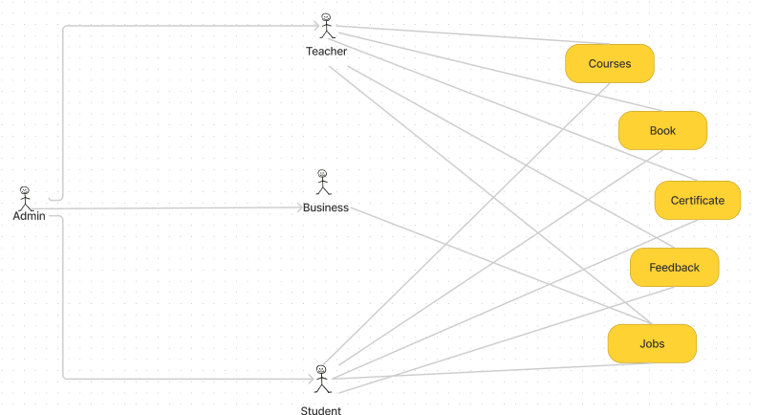
Use case diagram: Overview

Slide 10
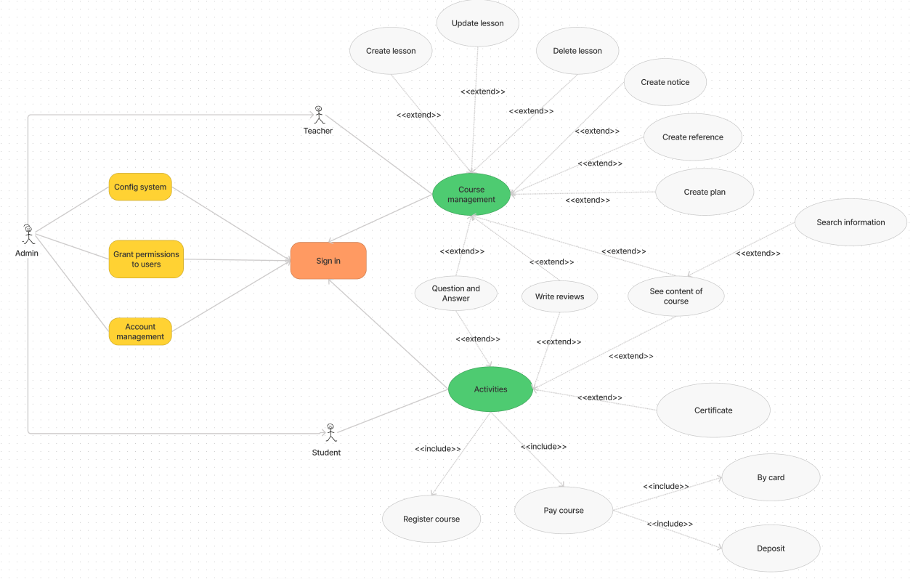
Use case diagram: Course management - activities

Slide 11
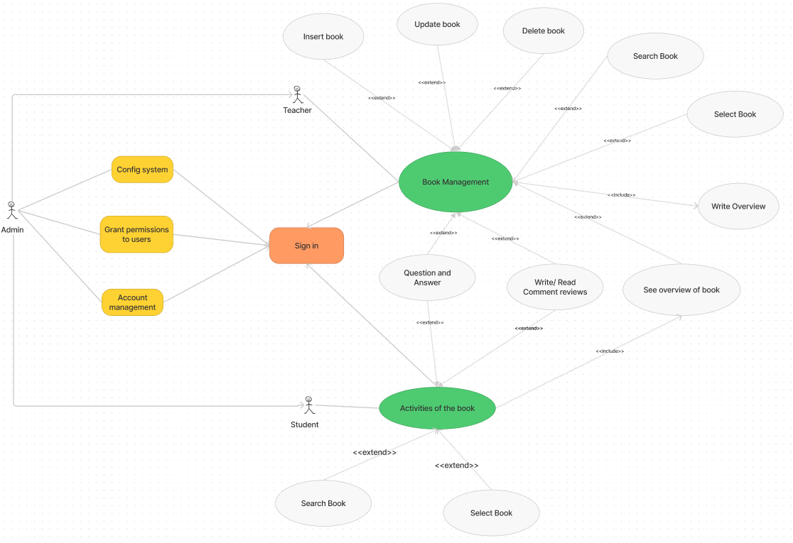
Use case diagram: Book management - activities

Slide 12
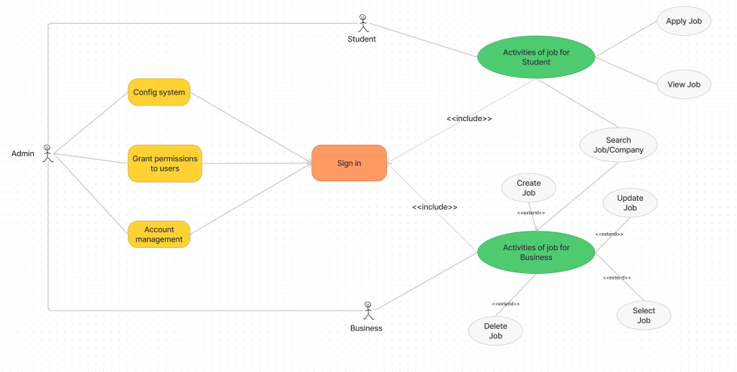
Use case diagram: Business management - activities

Slide 13
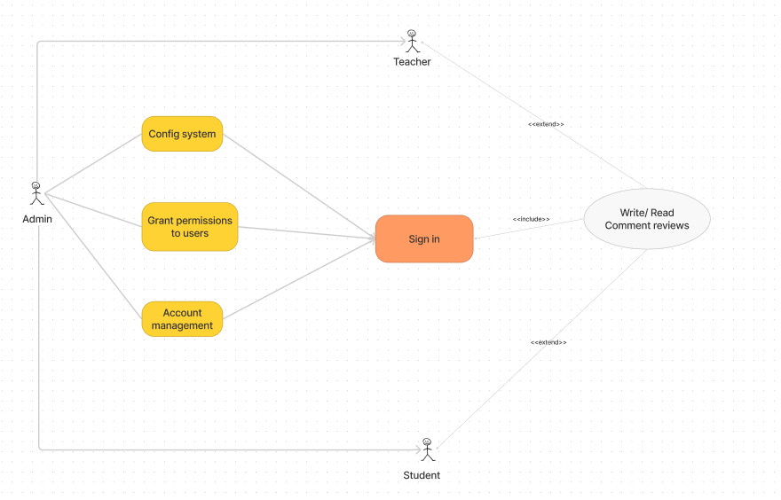
Use case diagram: Feedback management - activities

Slide 14
Flow chart:
Entity Relationship Diagram

Slide 15
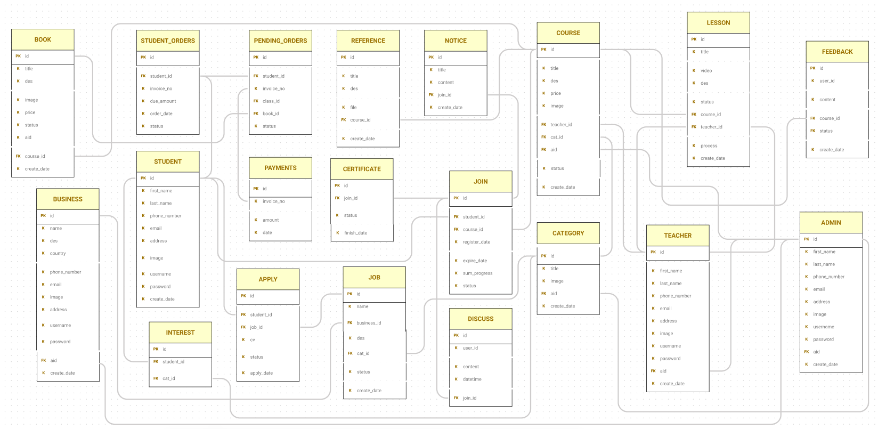

Slide 16
Flow chart:
Main Activity Diagram

Slide 17
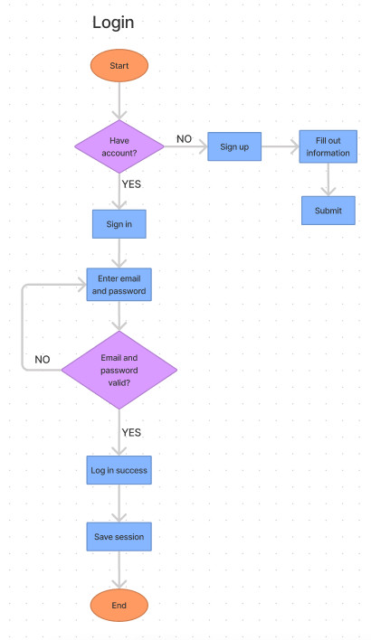
Activity: Login
Student

Slide 18
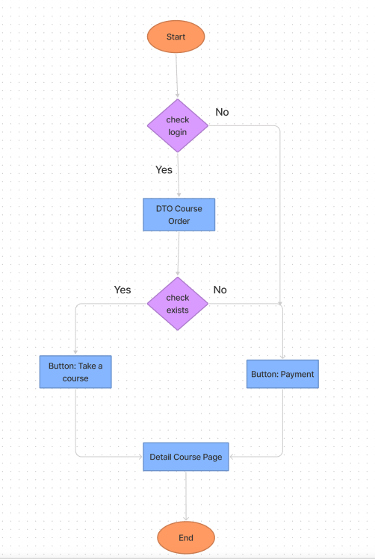
Activity: User visit to “Detail Course Page”
Student

Slide 19
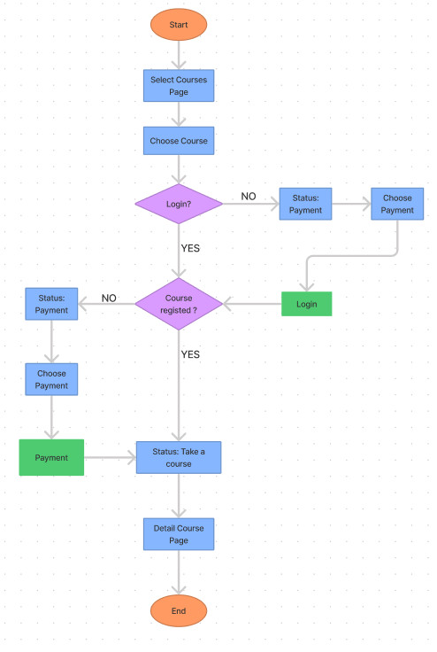
Activity: Register course
Student

Slide 20
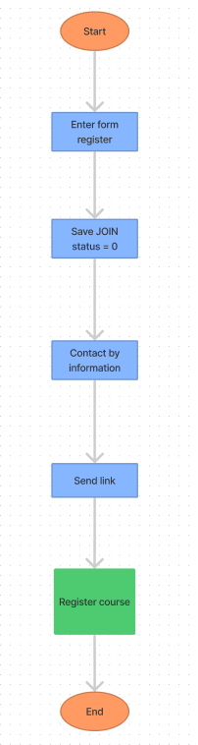
Activity: Quick Register course
Student

Slide 21
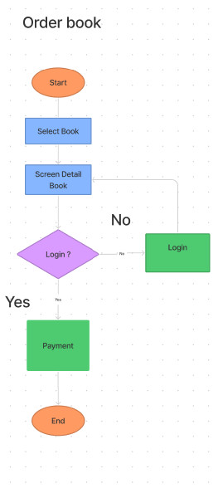
Activity: Order book
Student

Slide 22
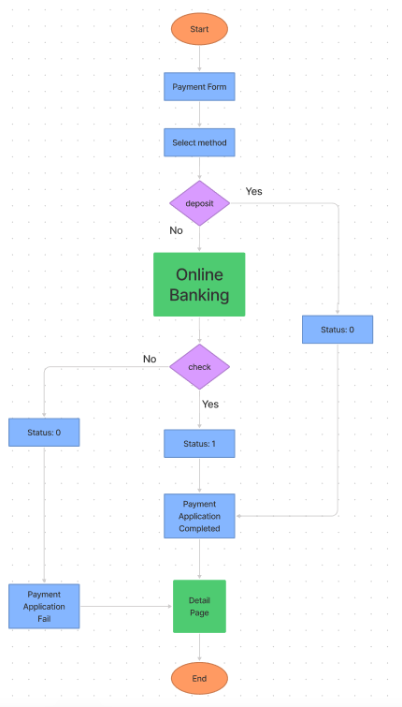
Activity: Payment
Student

Slide 23
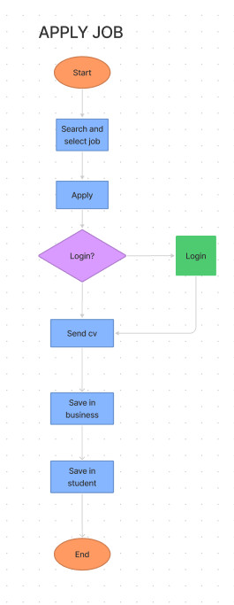
Activity: Apply job
Student

Slide 24
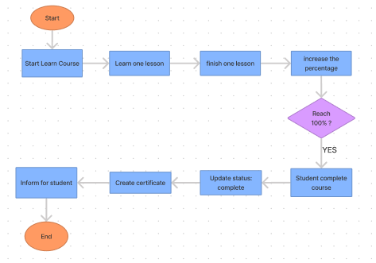
Activity: Create certificate when finish course
Student

Slide 25
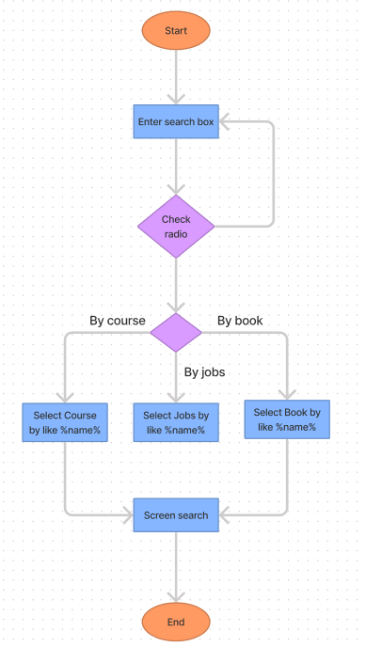
Activity: Create certificate when finish course
Student

Slide 26
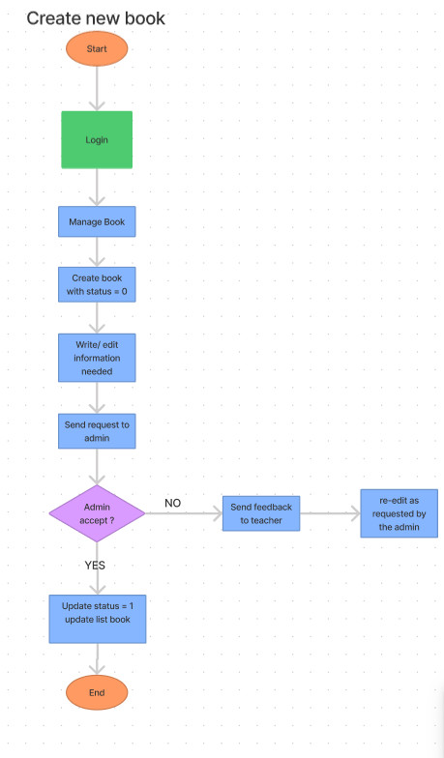
Activity: Request create new book
Instructor

Slide 27
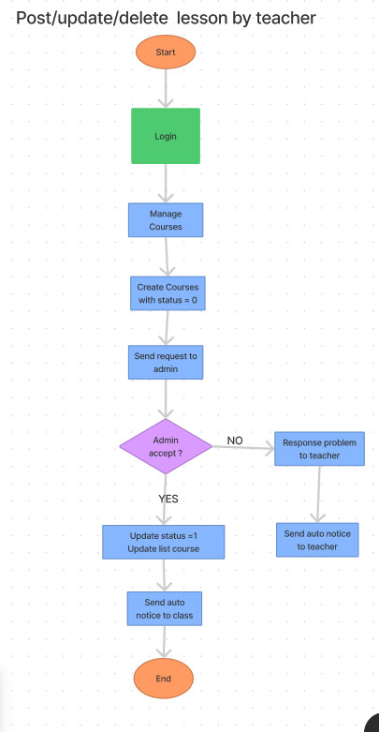
Activity: Request post/update/delete lesson
Instructor

Slide 28
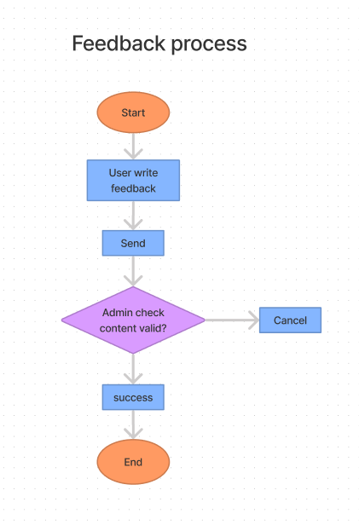
Activity: Feedback
Student
Instructor

Slide 29
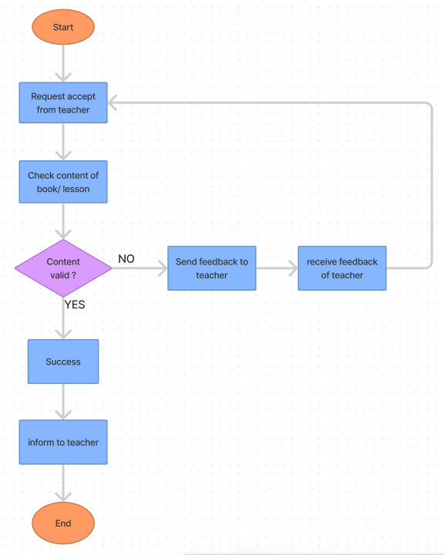
Activity: Accept request
Admin

Slide 30
Story board

Slide 31
Story board
Sign in – Sign up
Student

Slide 32
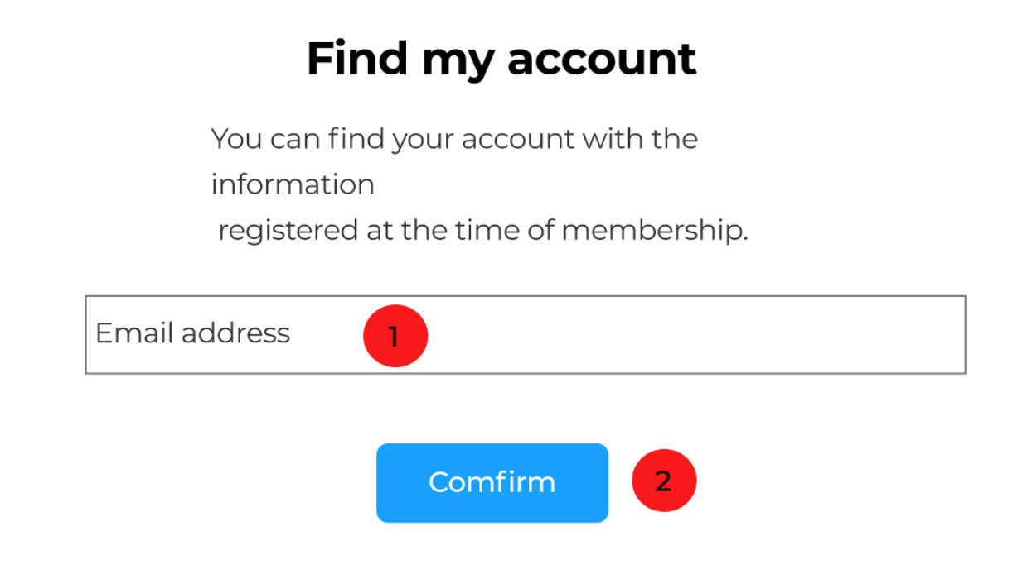
Number | Description
1 | Enter Email
2 | Send email to create new pass
Find account

Slide 33
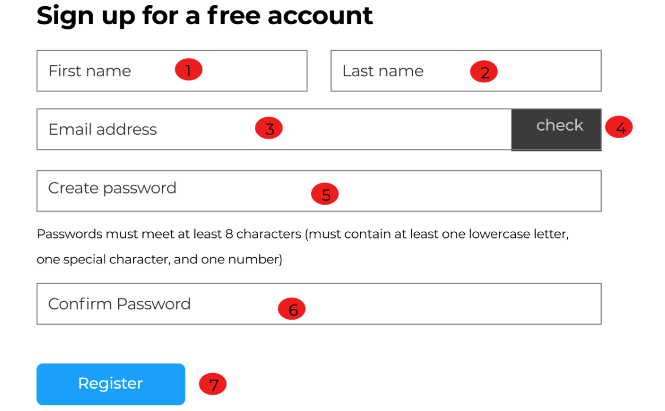
Number | Description
1 | First name
2 | Last name
3 | Email
4 | Check if email not “@”
5 | Password
6 | Check password
7 | Register
Sign up for account

Slide 34
Student
Story board:
Information User
Instructor

Slide 35
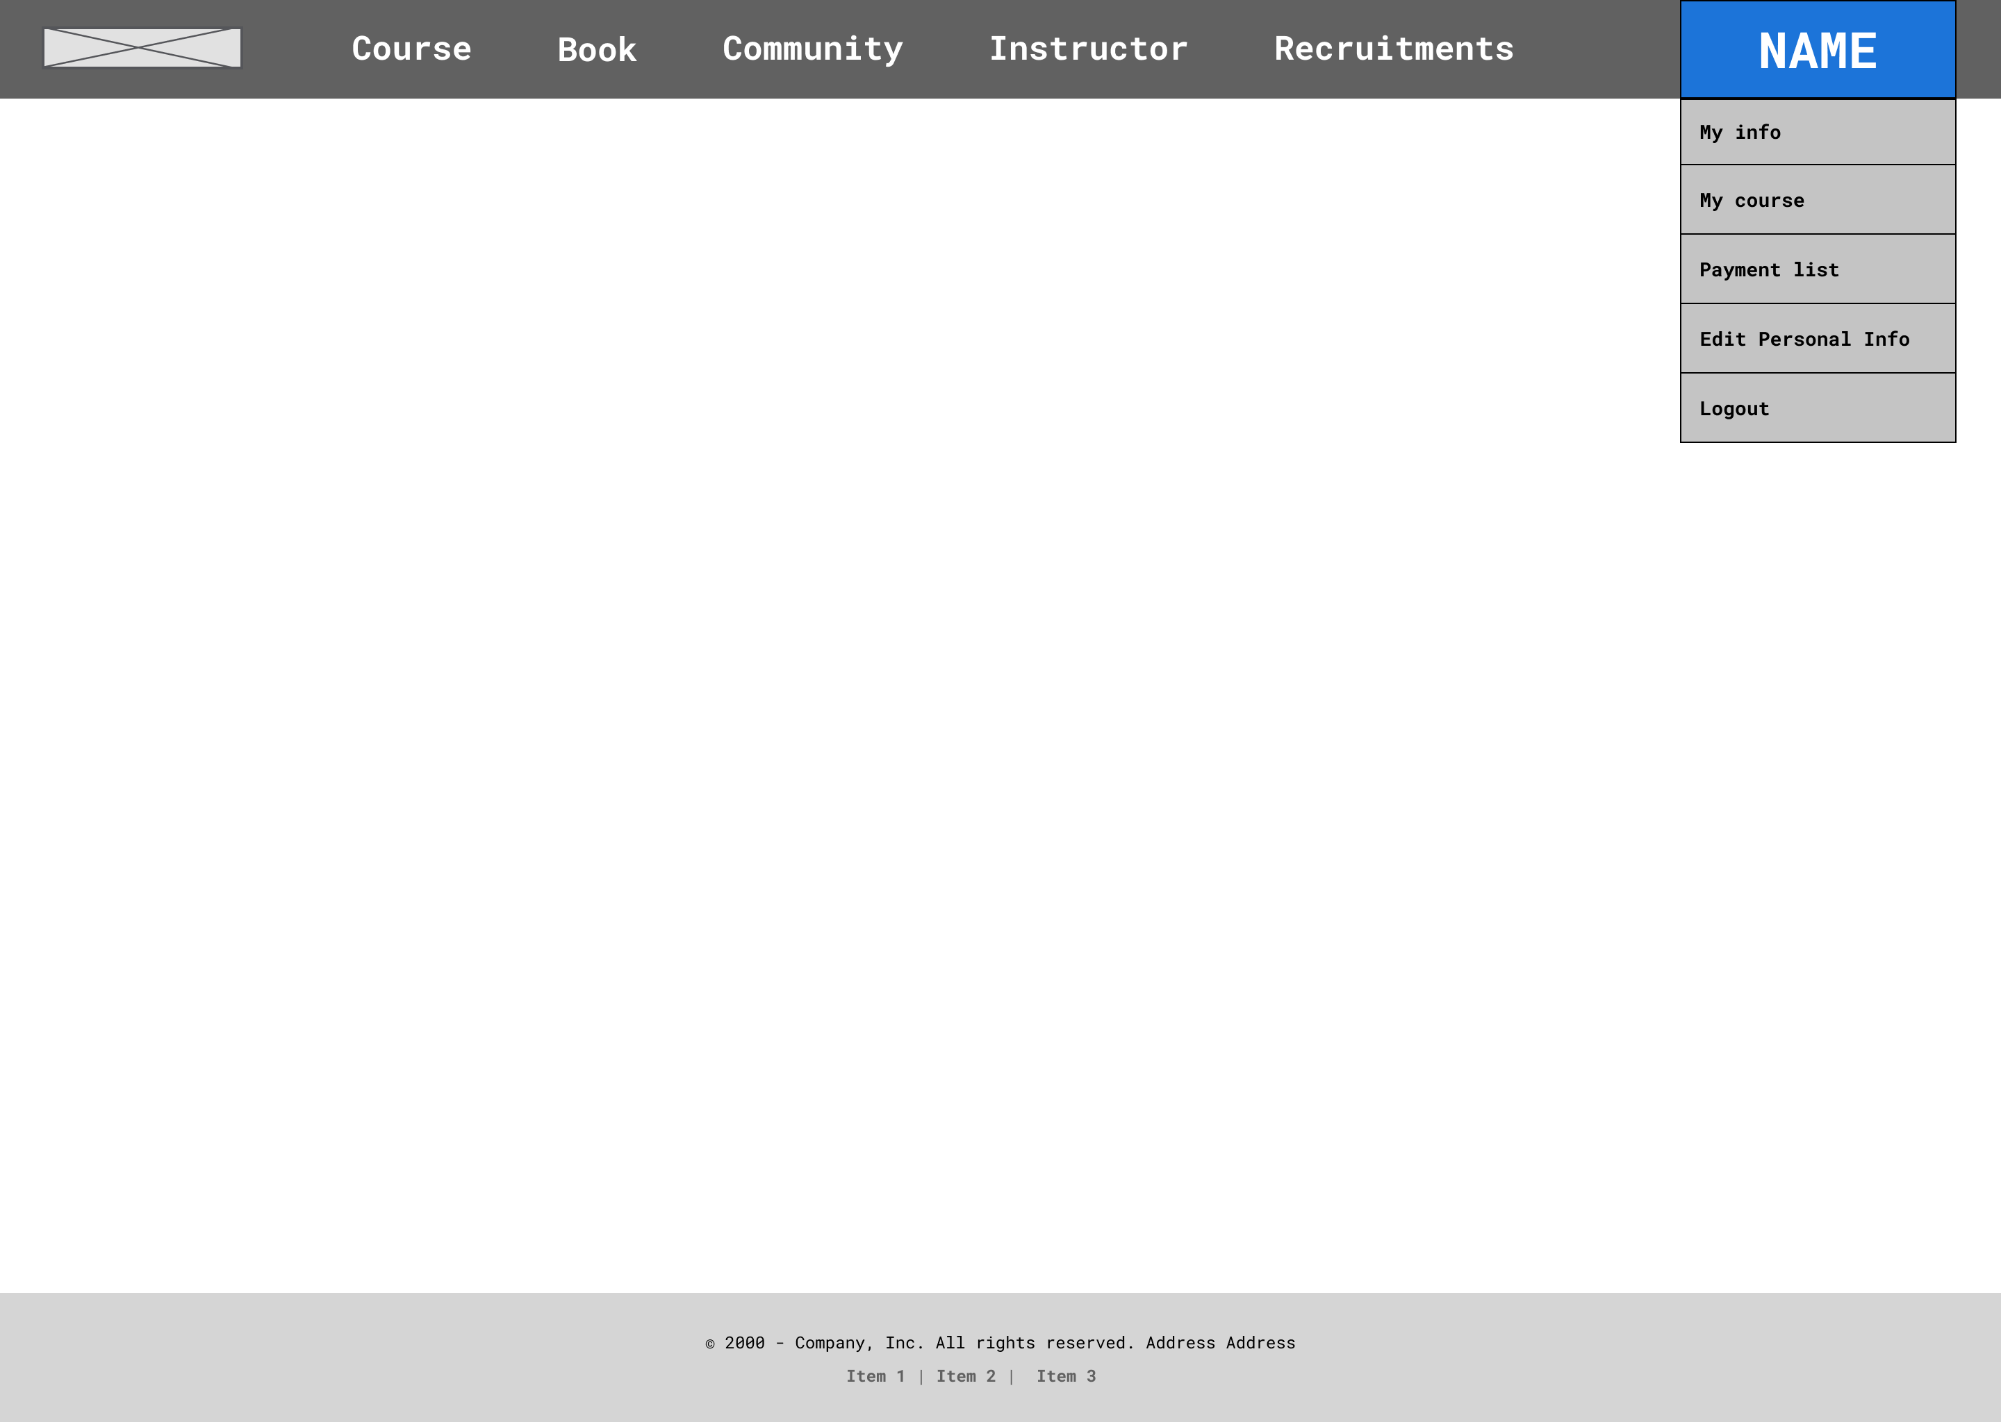
Number | Description
1 | Tab main menu
2 | Tab “my info” → to show dashboard account
3 | Tab “my course” → to show all enrolled course information
4 | Tab “payment list” → to show history payment information
5 | Tab “edit personal info” → to change personal information
6 | Tab “logout” → to sign out
Main Menu
Student
Instructor
1
2
3
4
5
6

Slide 36
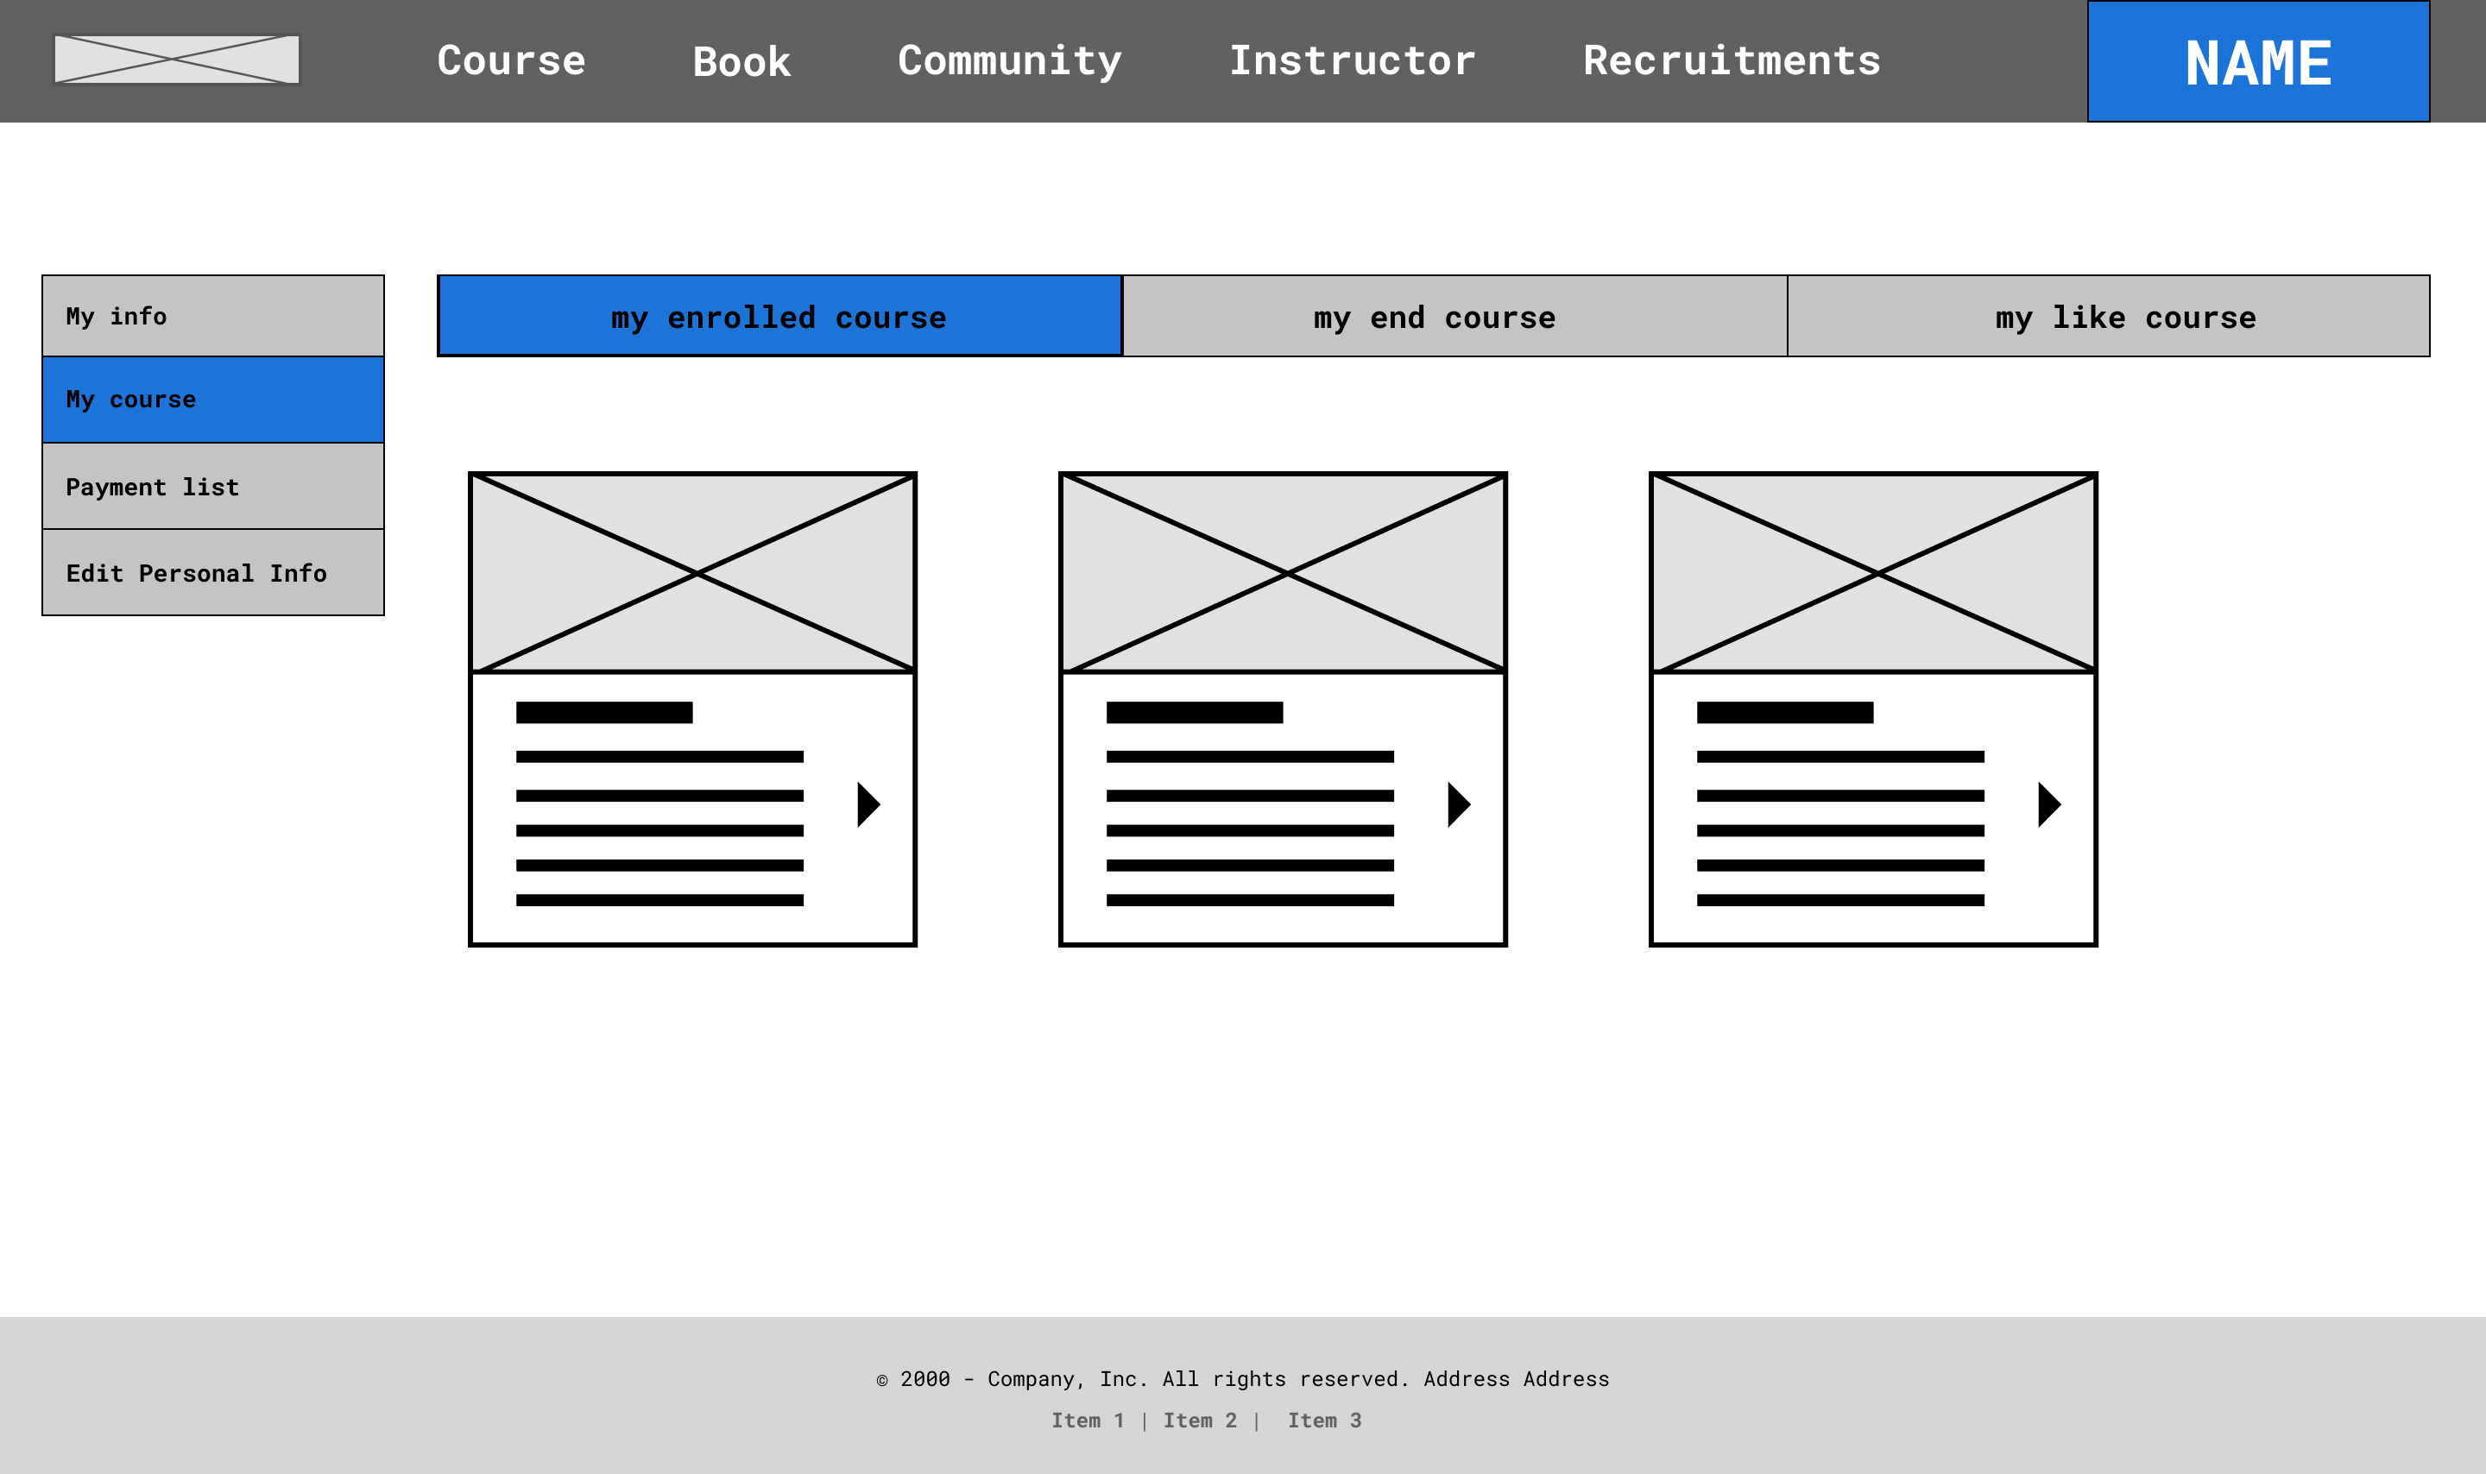
Number | Description
1 | Tab “my course” → to show all courses information
2 | Tab “my enrolled course” → show all enrolled course information
3 | Show all enrolled courses list
Personal Information Page → my enrolled course
Student
2
1
3

Slide 37
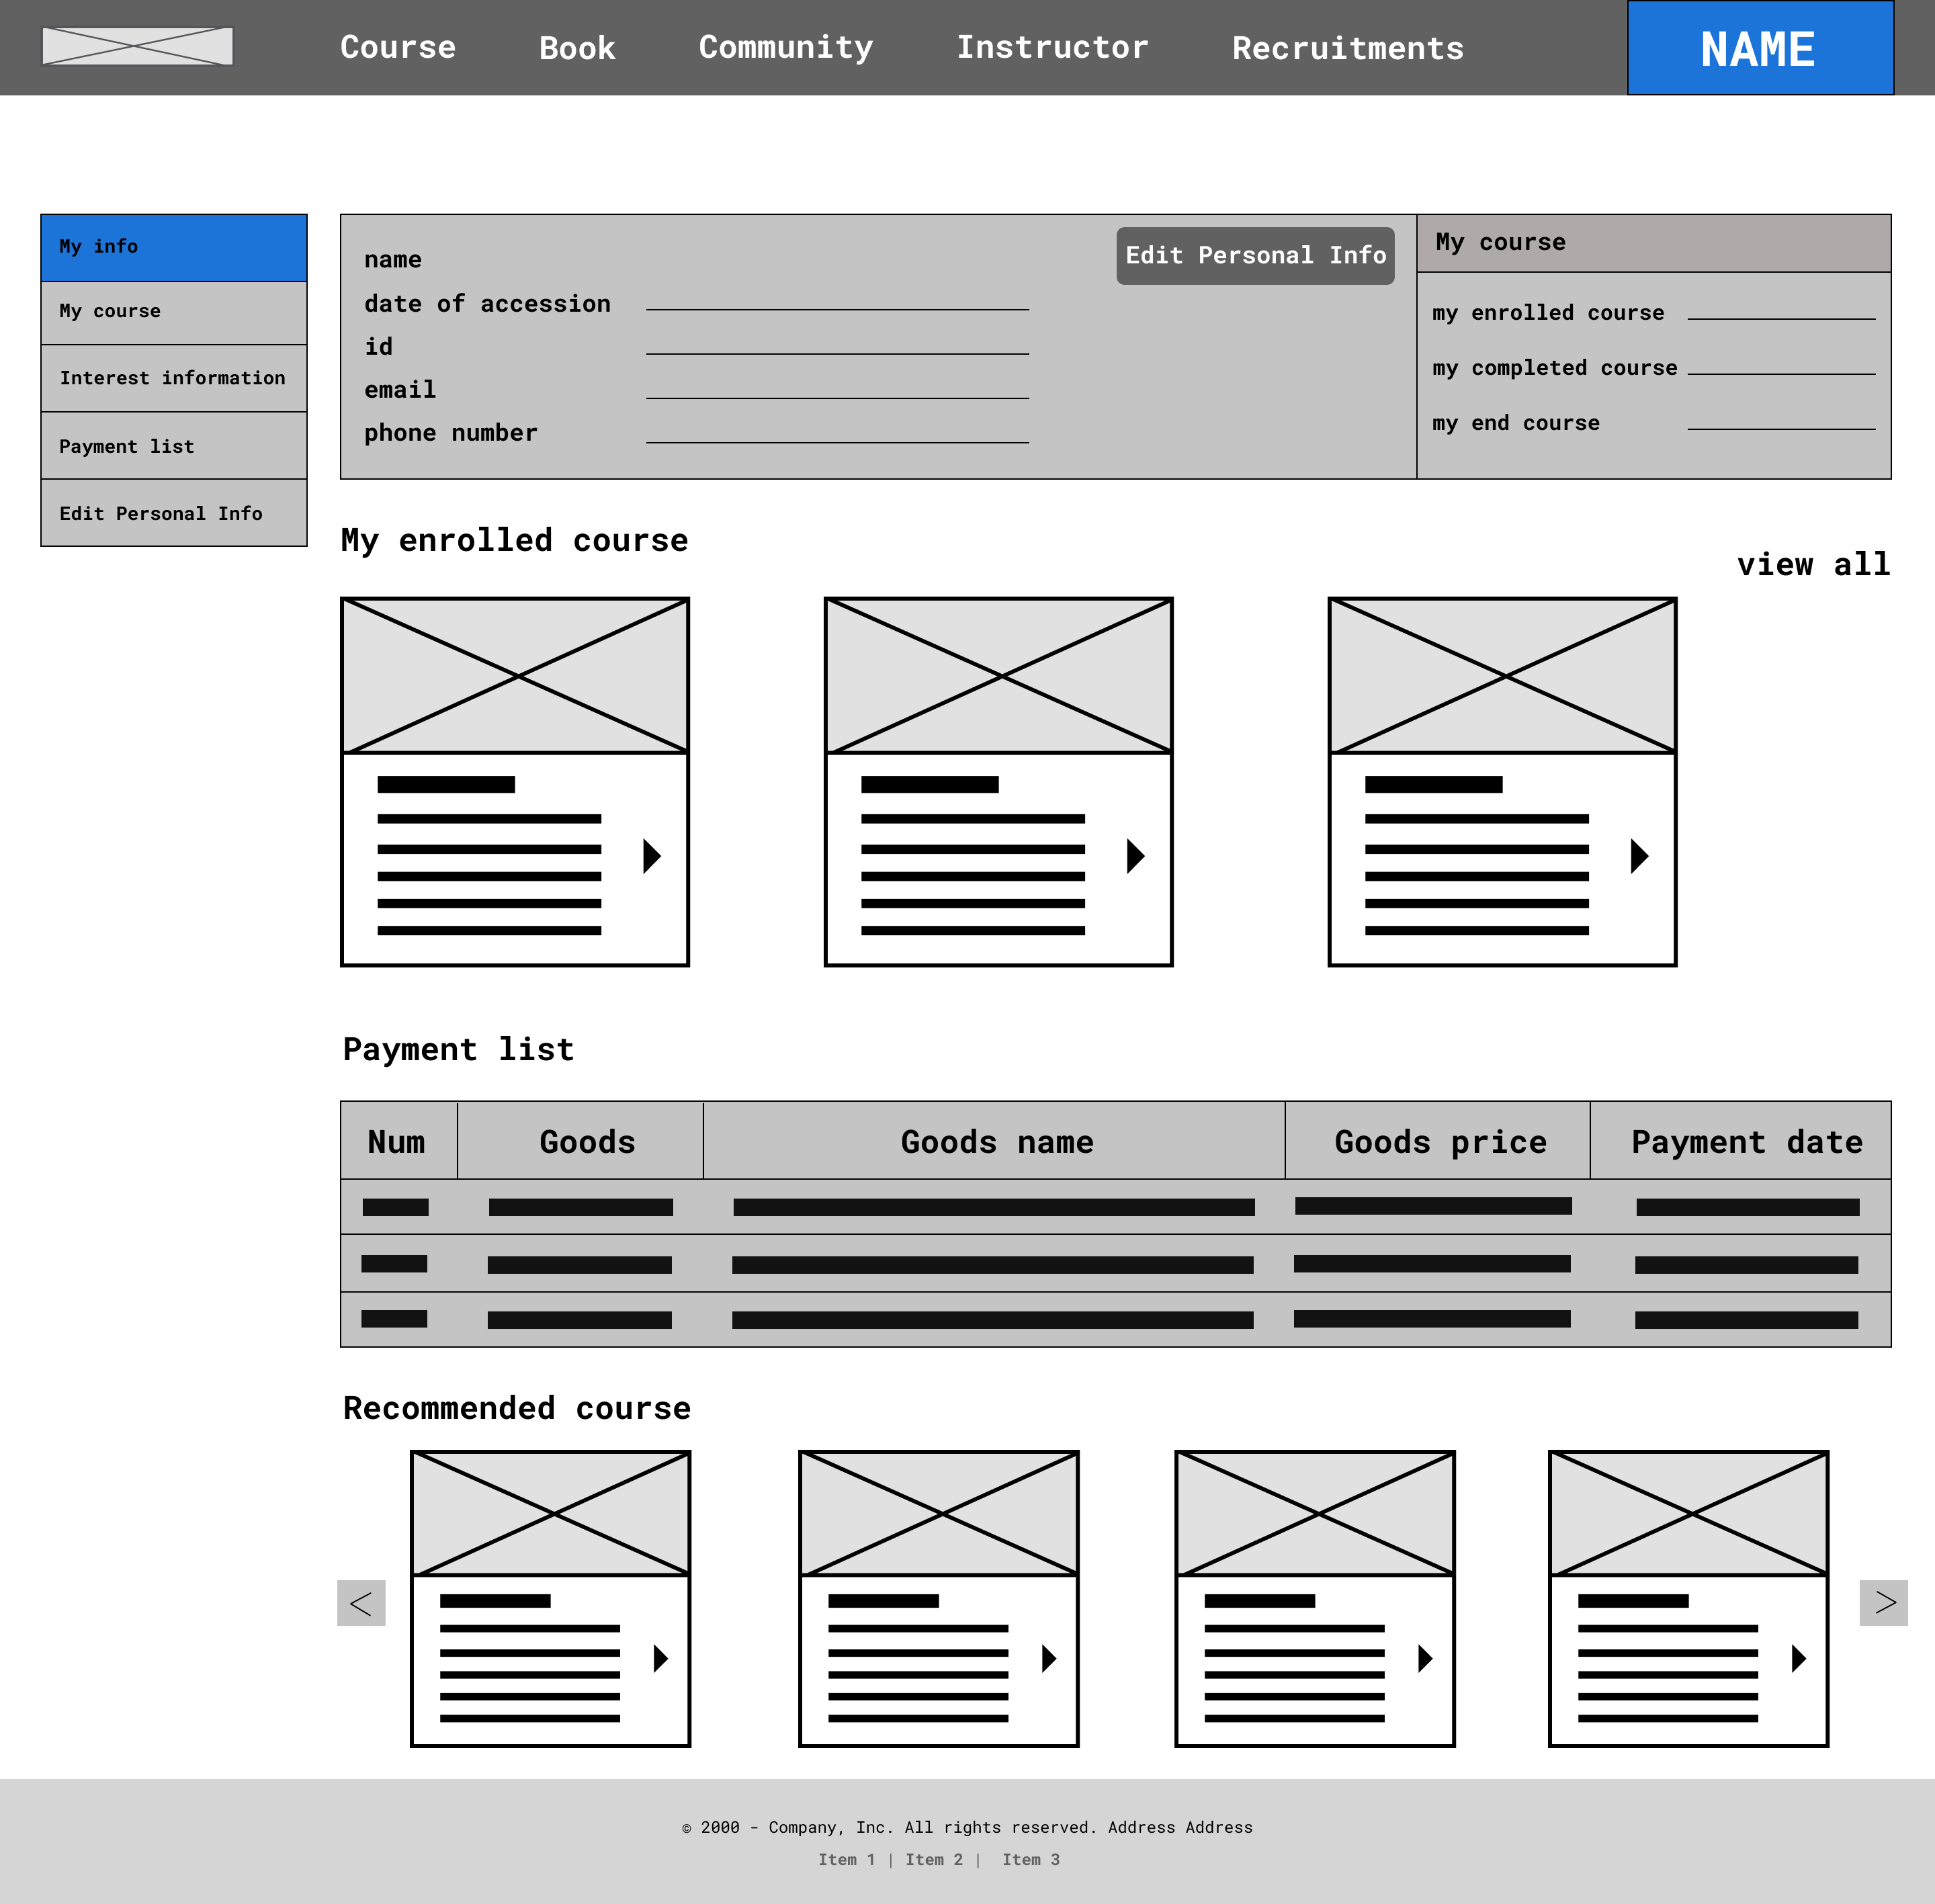
Number | Description
1 | Tab “my info” → to show dashboard account
2 | Show the user information about : date of accession, id, email, phone number
3 | Button “Edit Person Info” -> Go to Edit Personal Info Page
4 | Show the course information
5 | Show the information about enrolled courses
6 | Show all enrolled courses
7 | Show payment list information
8 | Show the recommended courses
Personal Information Page → My info
Student
1
2
3
4
5
6
7
8

Slide 38
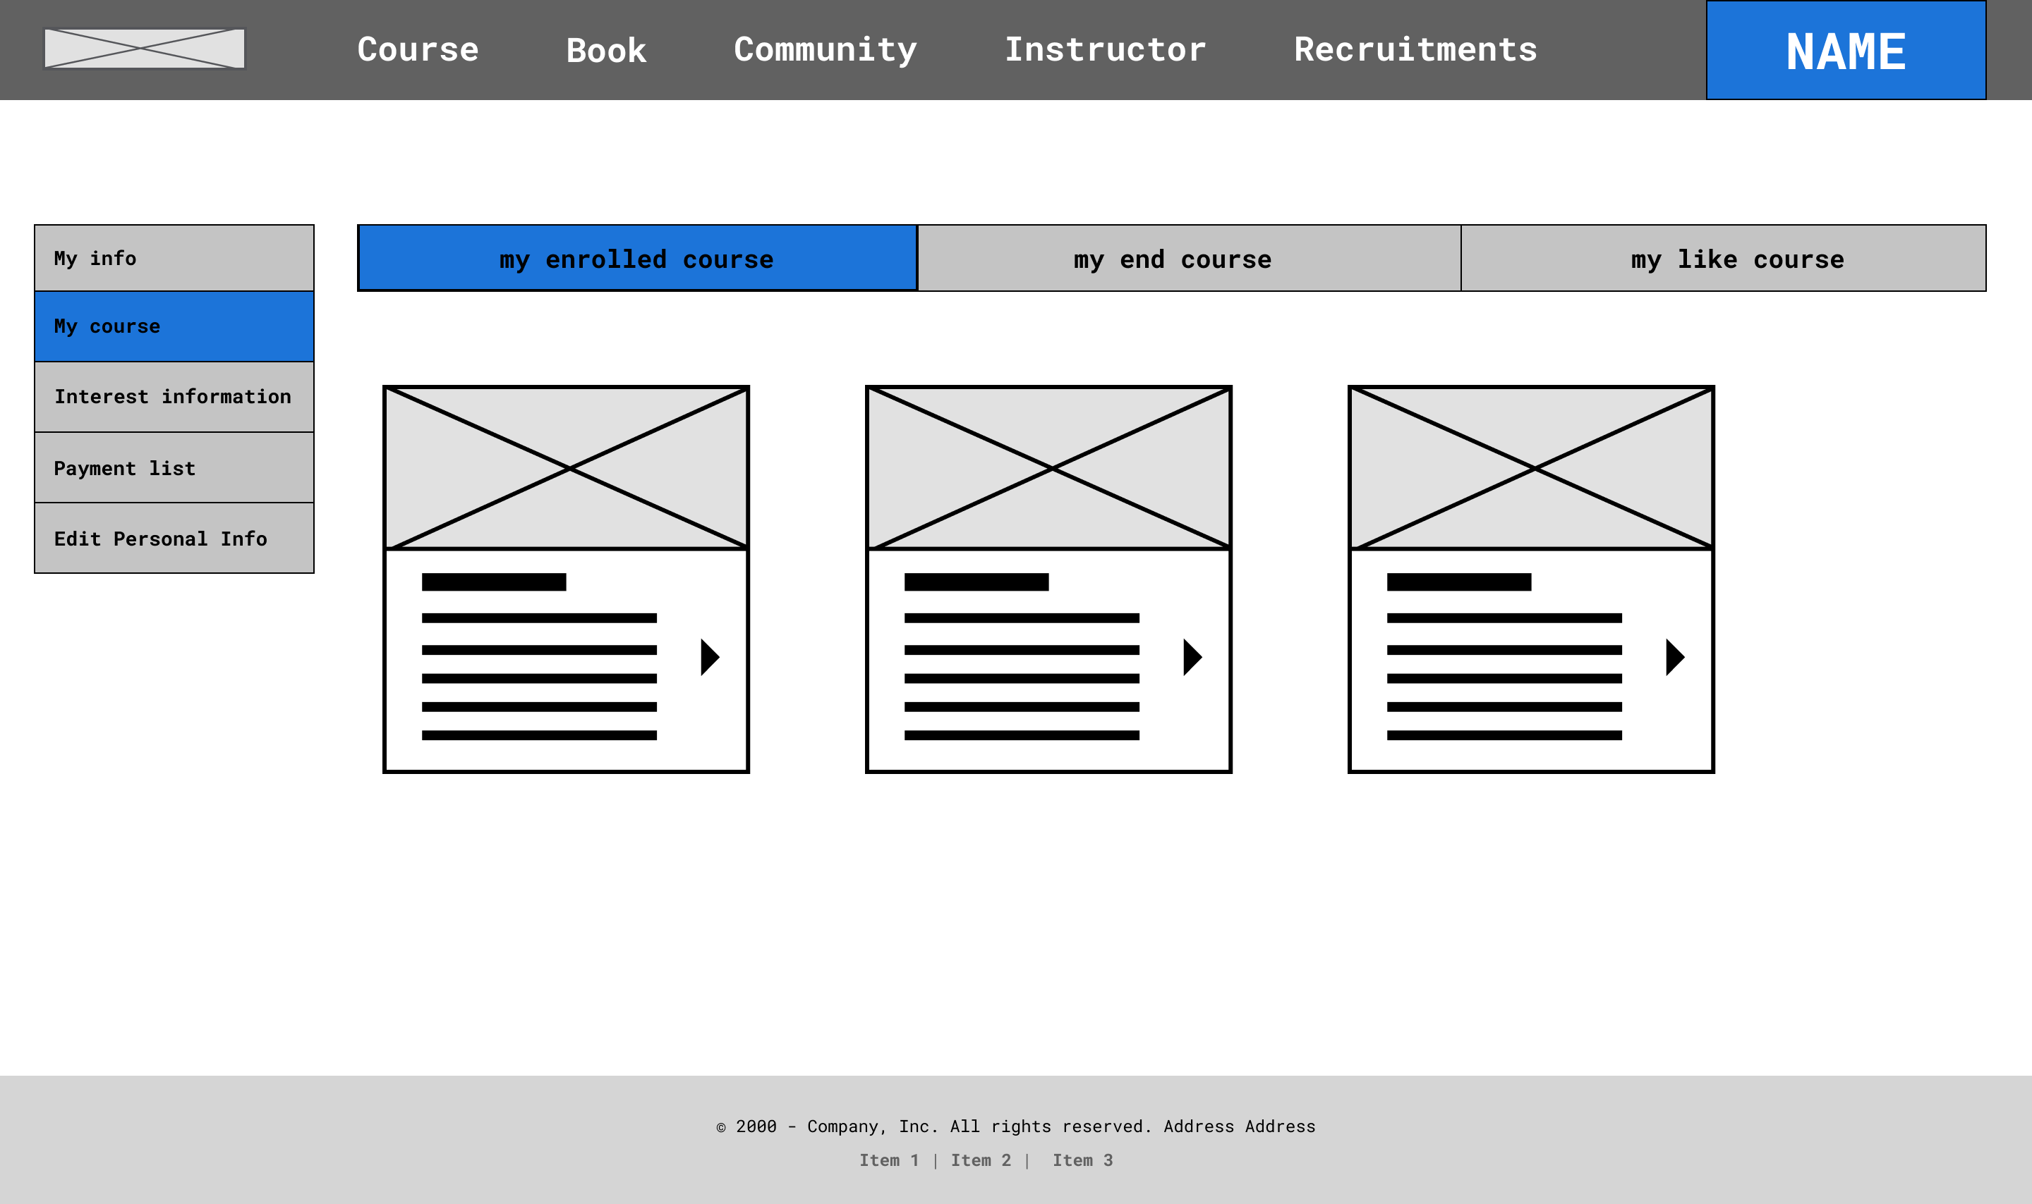
Number | Description
1 | Tab “my course” → to show all courses information
2 | Tab “my enrolled course” → show all enrolled course information
3 | Show all enrolled courses list
Personal Information Page → my enrolled course
Student
2
1
3

Slide 39
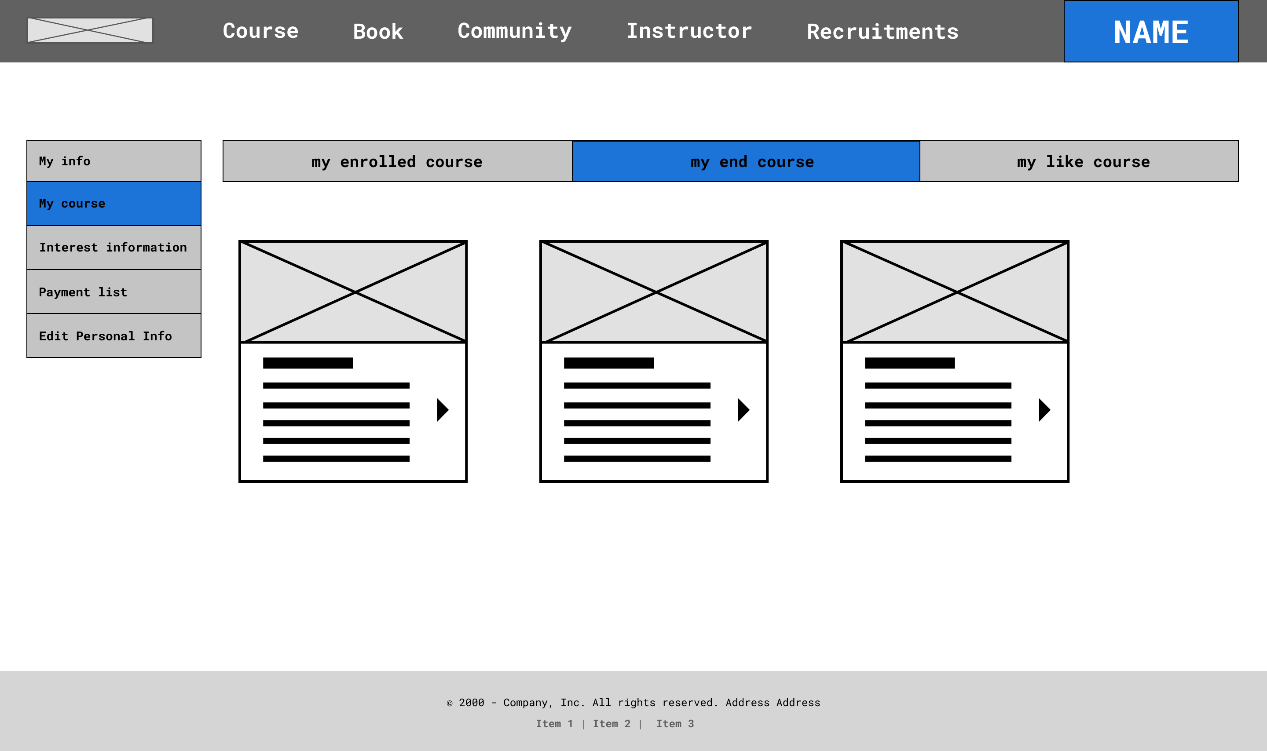
Number | Description
1 | Tab “my end course” →show the end course
2 | Show all end course list
Personal Information Page → my end course
Student
1
2

Slide 40
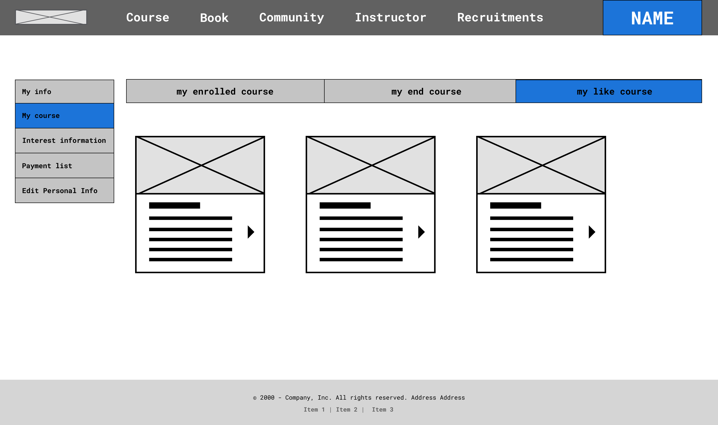
Number | Description
1 | Tab “my like course” →show the like course
2 | Show all like course list
Personal Information Page → my like course
Student
1
2

Slide 41
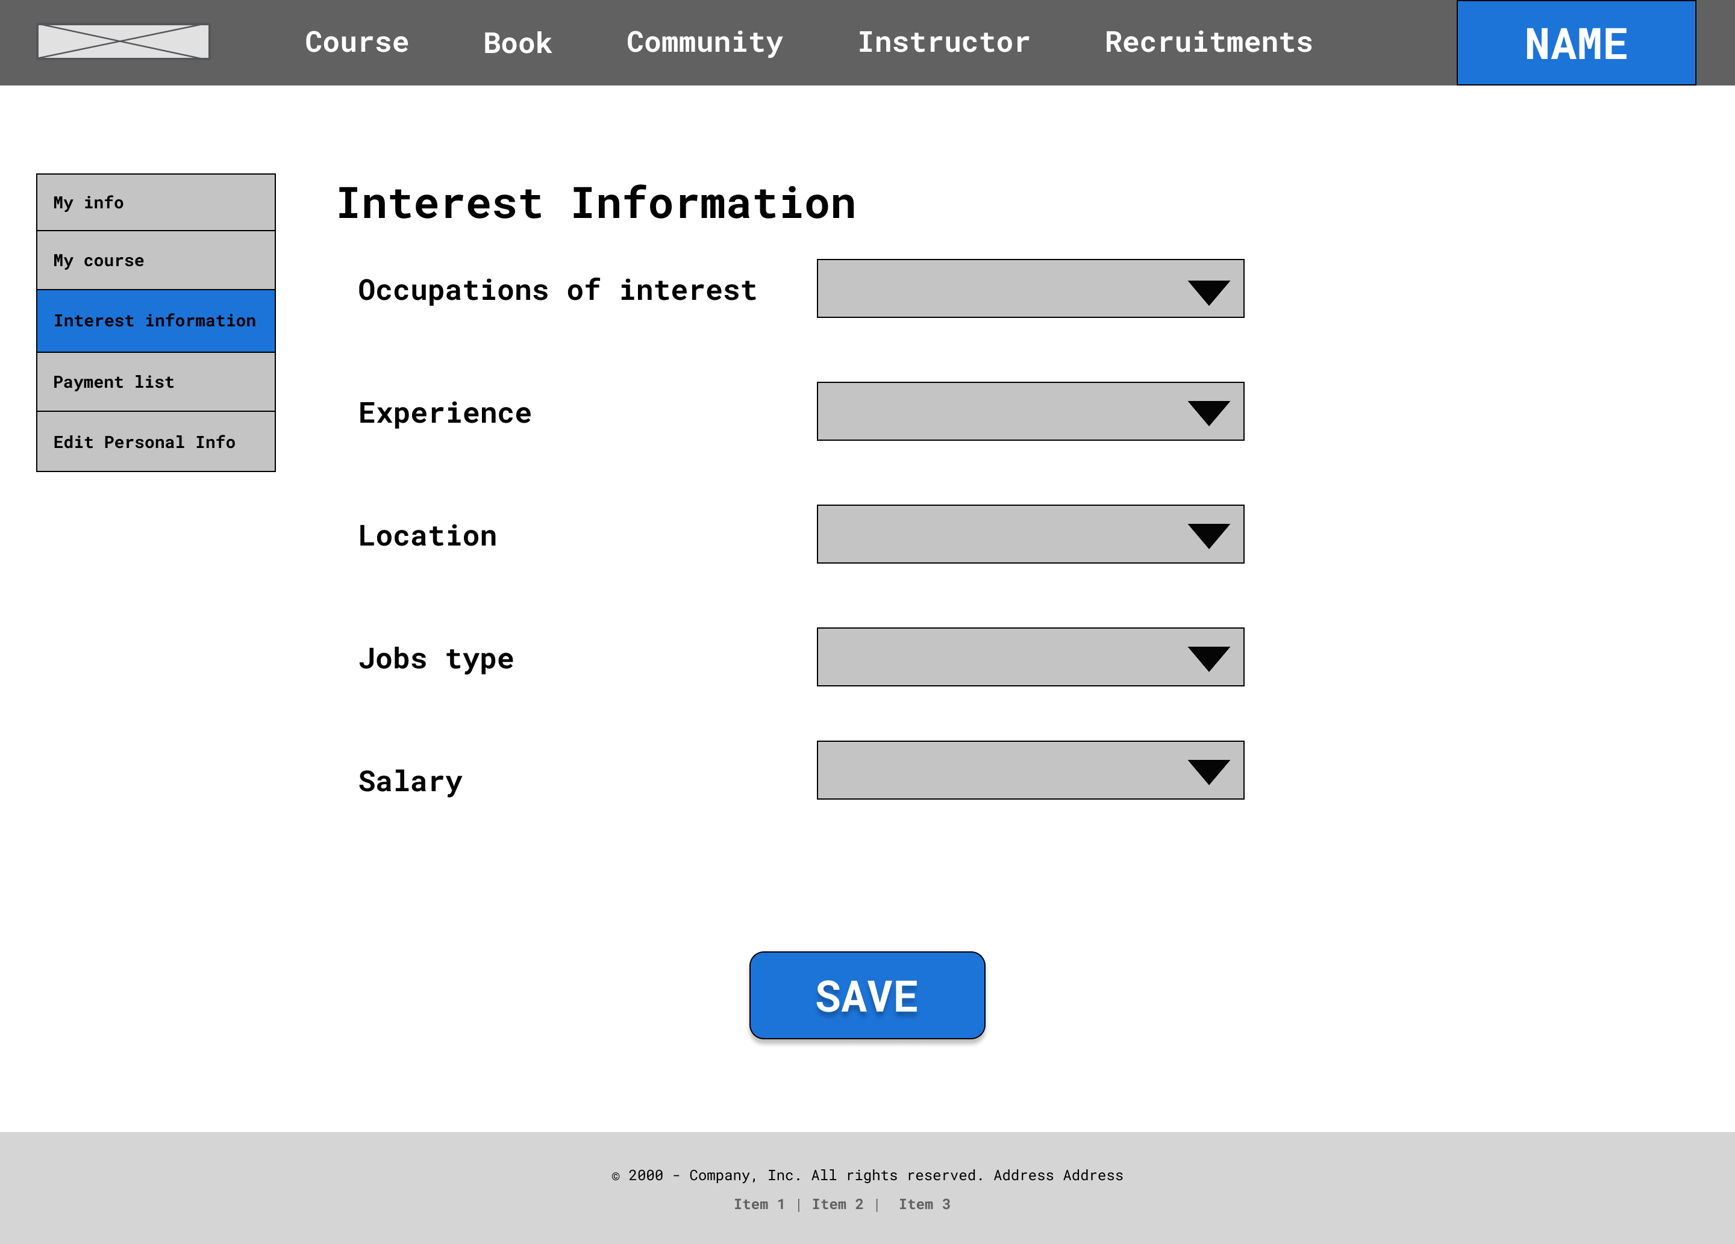
Number | Description
1 | Tab “Interest information” → setting interest to find jobs
2 | Show options to user can choose
3 | Button “SAVE” → save information
Interest Information Page
Student
2
1
3

Slide 42
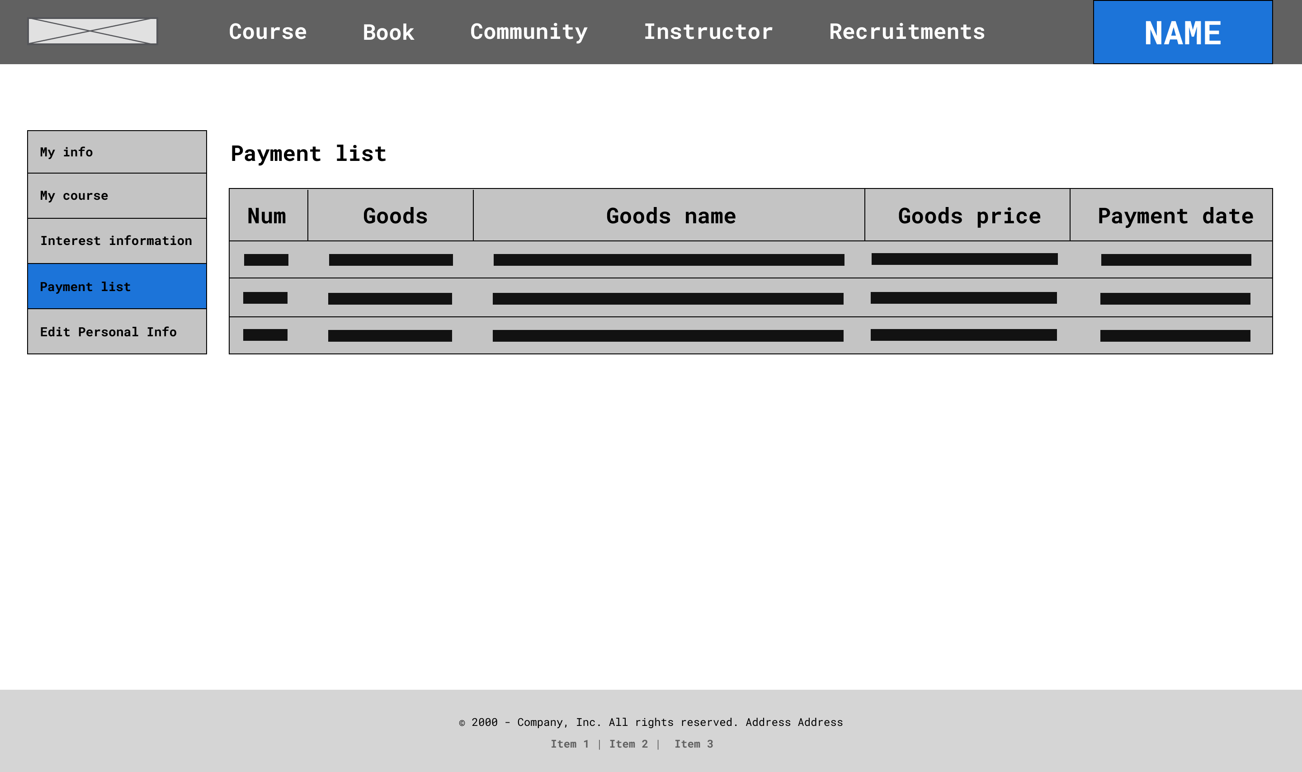
Number | Description
1 | Tab “payment list” → to show payment information
2 | Show all history payment list
Personal Information Page → payment list
Student
2
1

Slide 43
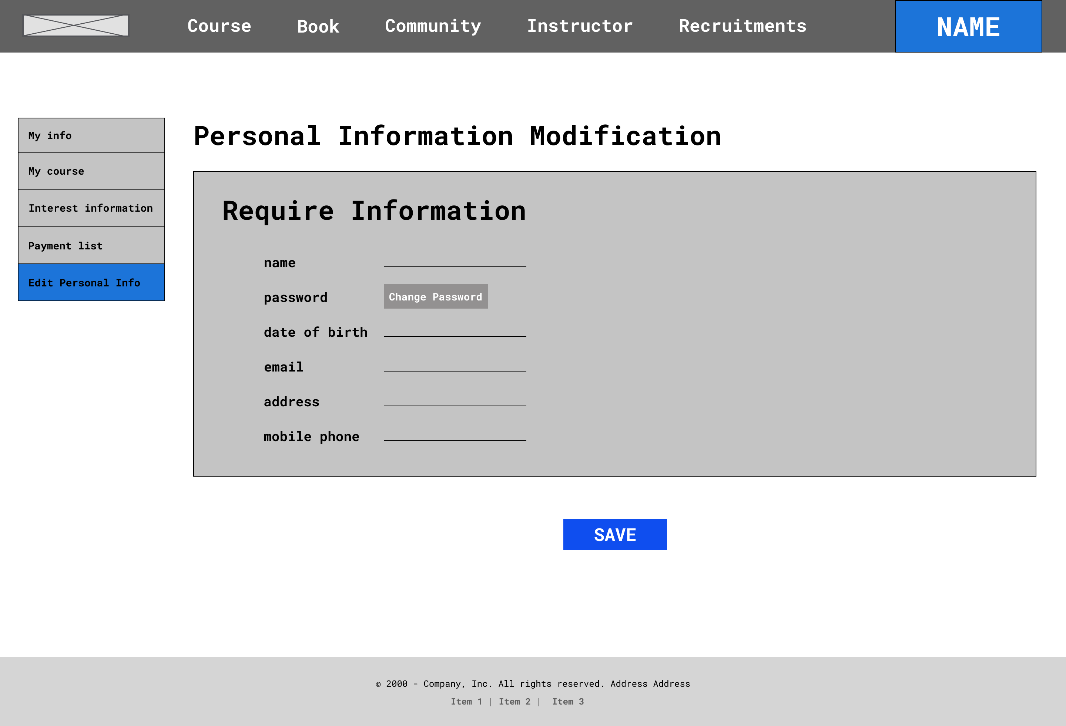
Number | Description
1 | Tab “edit personal info” → to show all personal info
2 | Show all history payment list
3 | Button “change password” → go to change password page
4 | Button “Save” → update new information
Personal Information Page
2
1
3
4

Slide 44
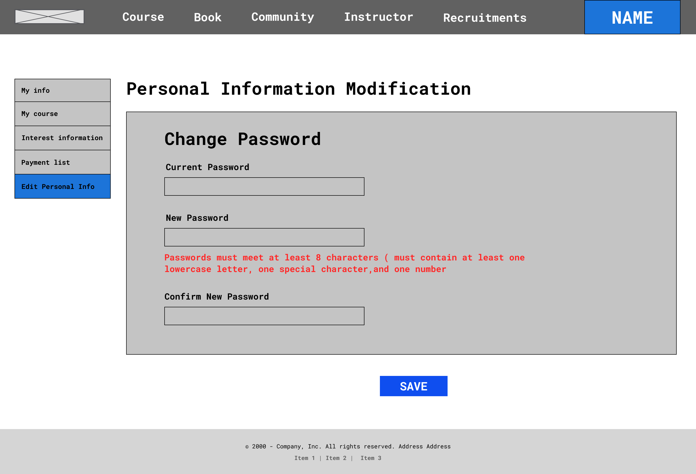
Number | Description
1 | Input current password
2 | Input new password
3 | Confirm new password
4 | Button “Save” → update new password
Edit Personal Information Page
1
2
3
4

Slide 45
Story board:
View detail course
Student

Slide 46
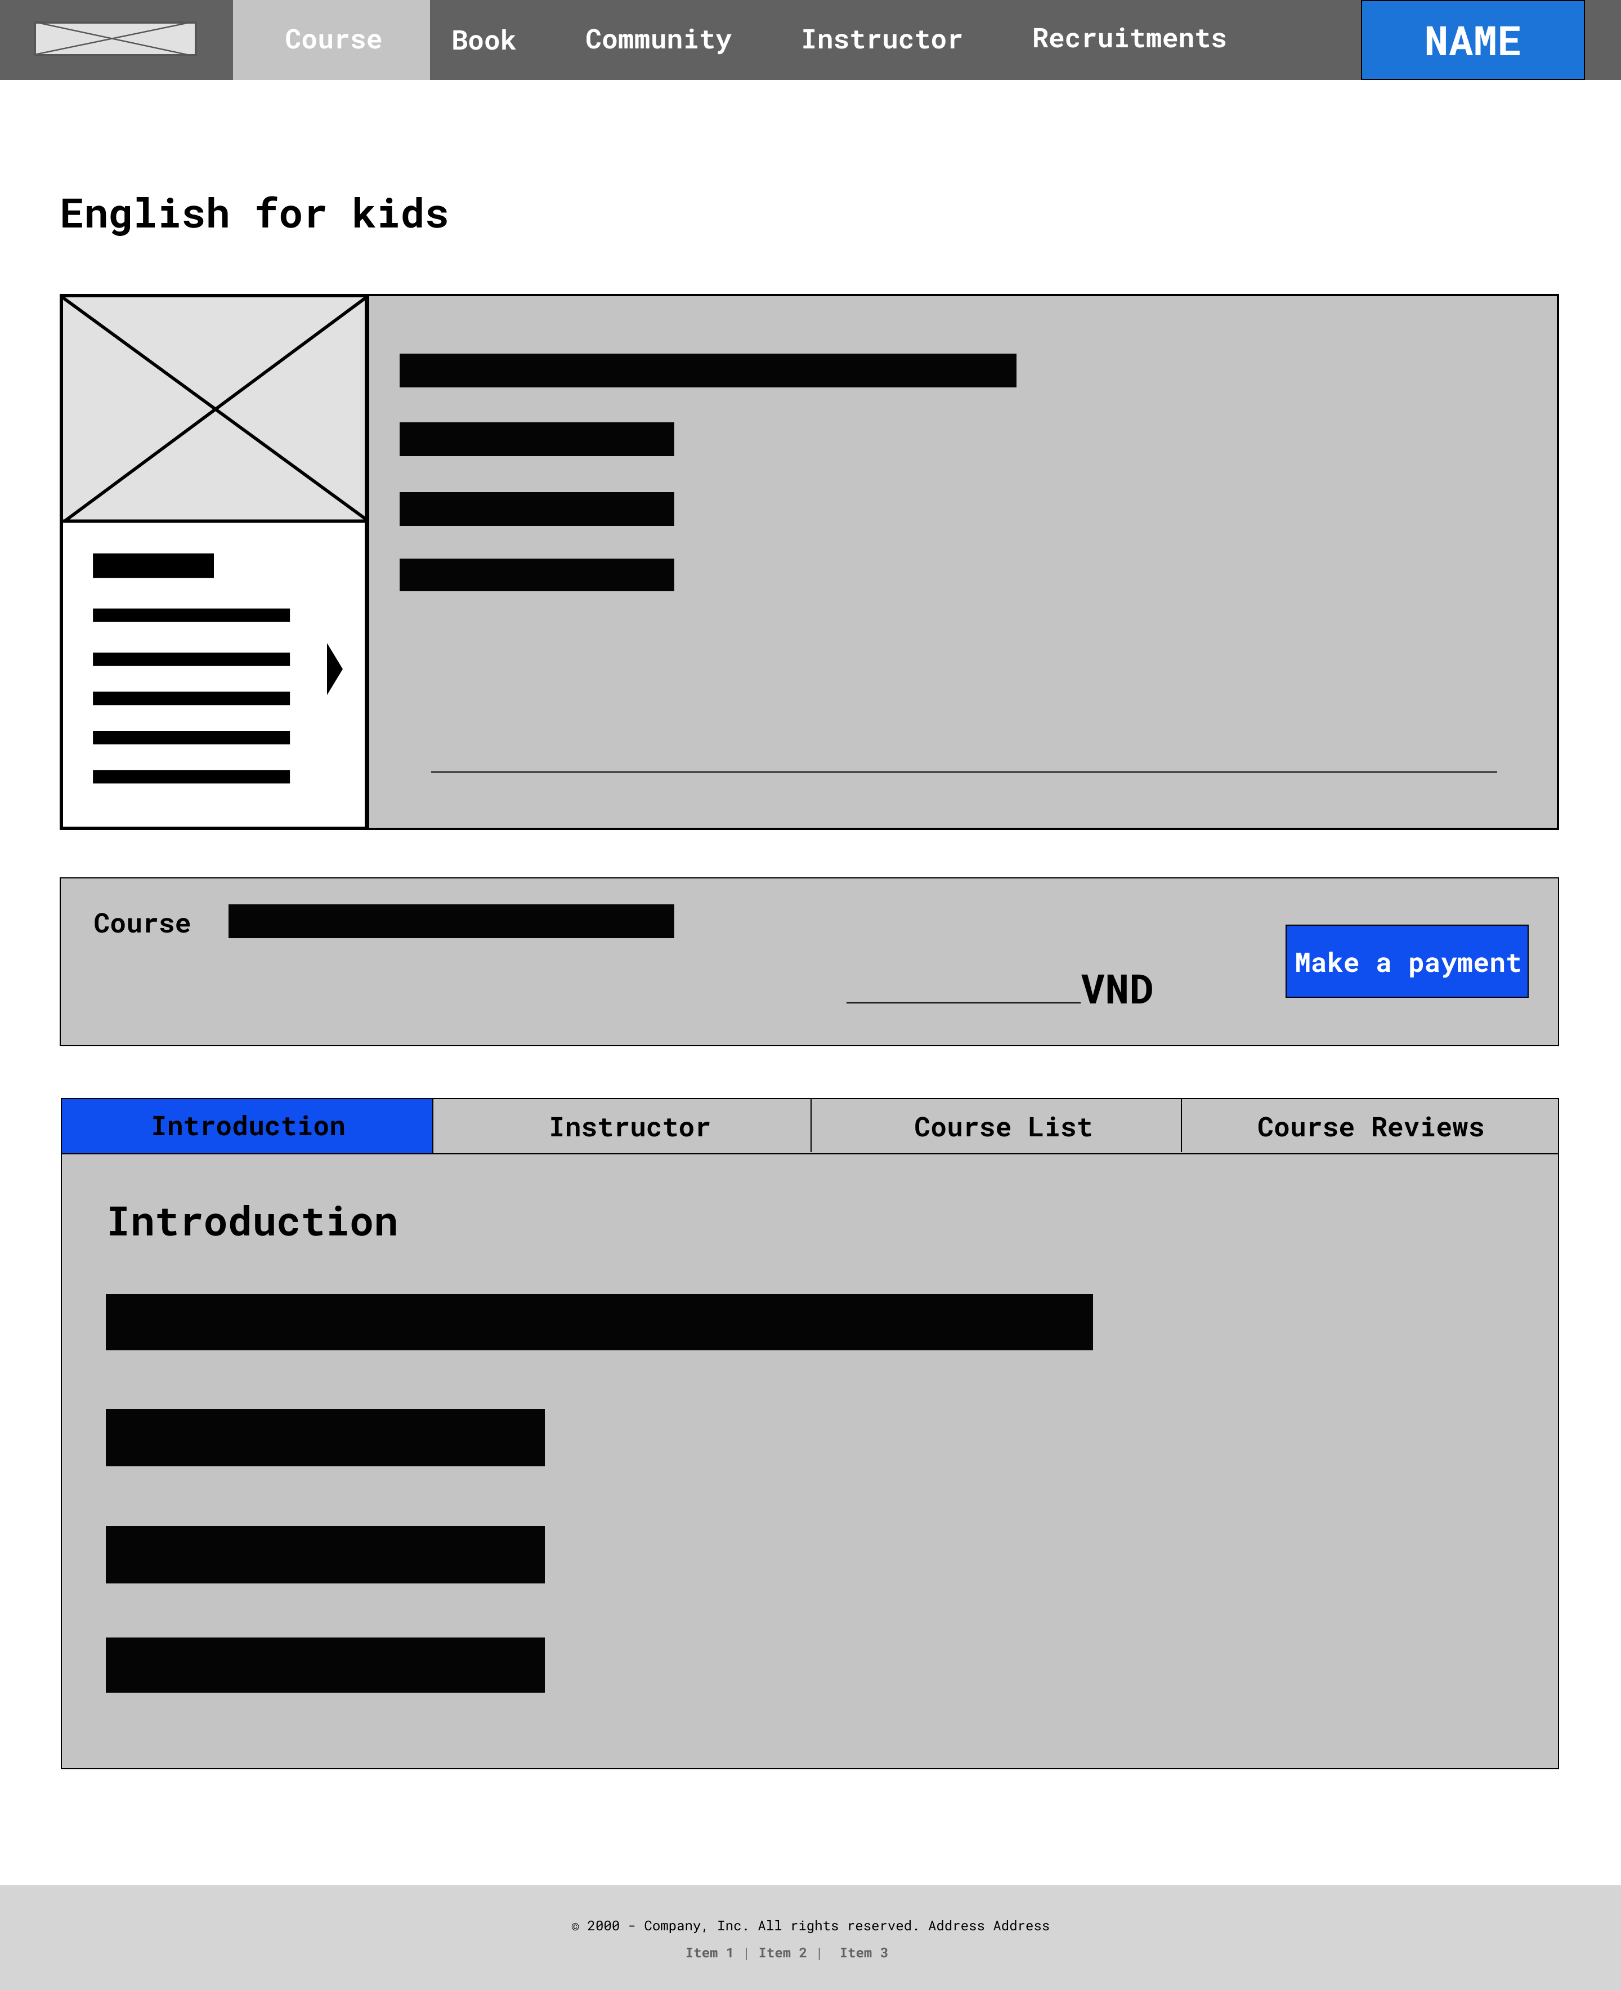
Number | Description
1 | Image of course
2 | Introduction of course
3 | Name and price course
4 | When click button → join class(if registered status is “Payment”)
5 | When click tab → show detail courses
6 | Detail course information
Detail Course – Information (Introduction)
1
2
3
4
5
6

Slide 47
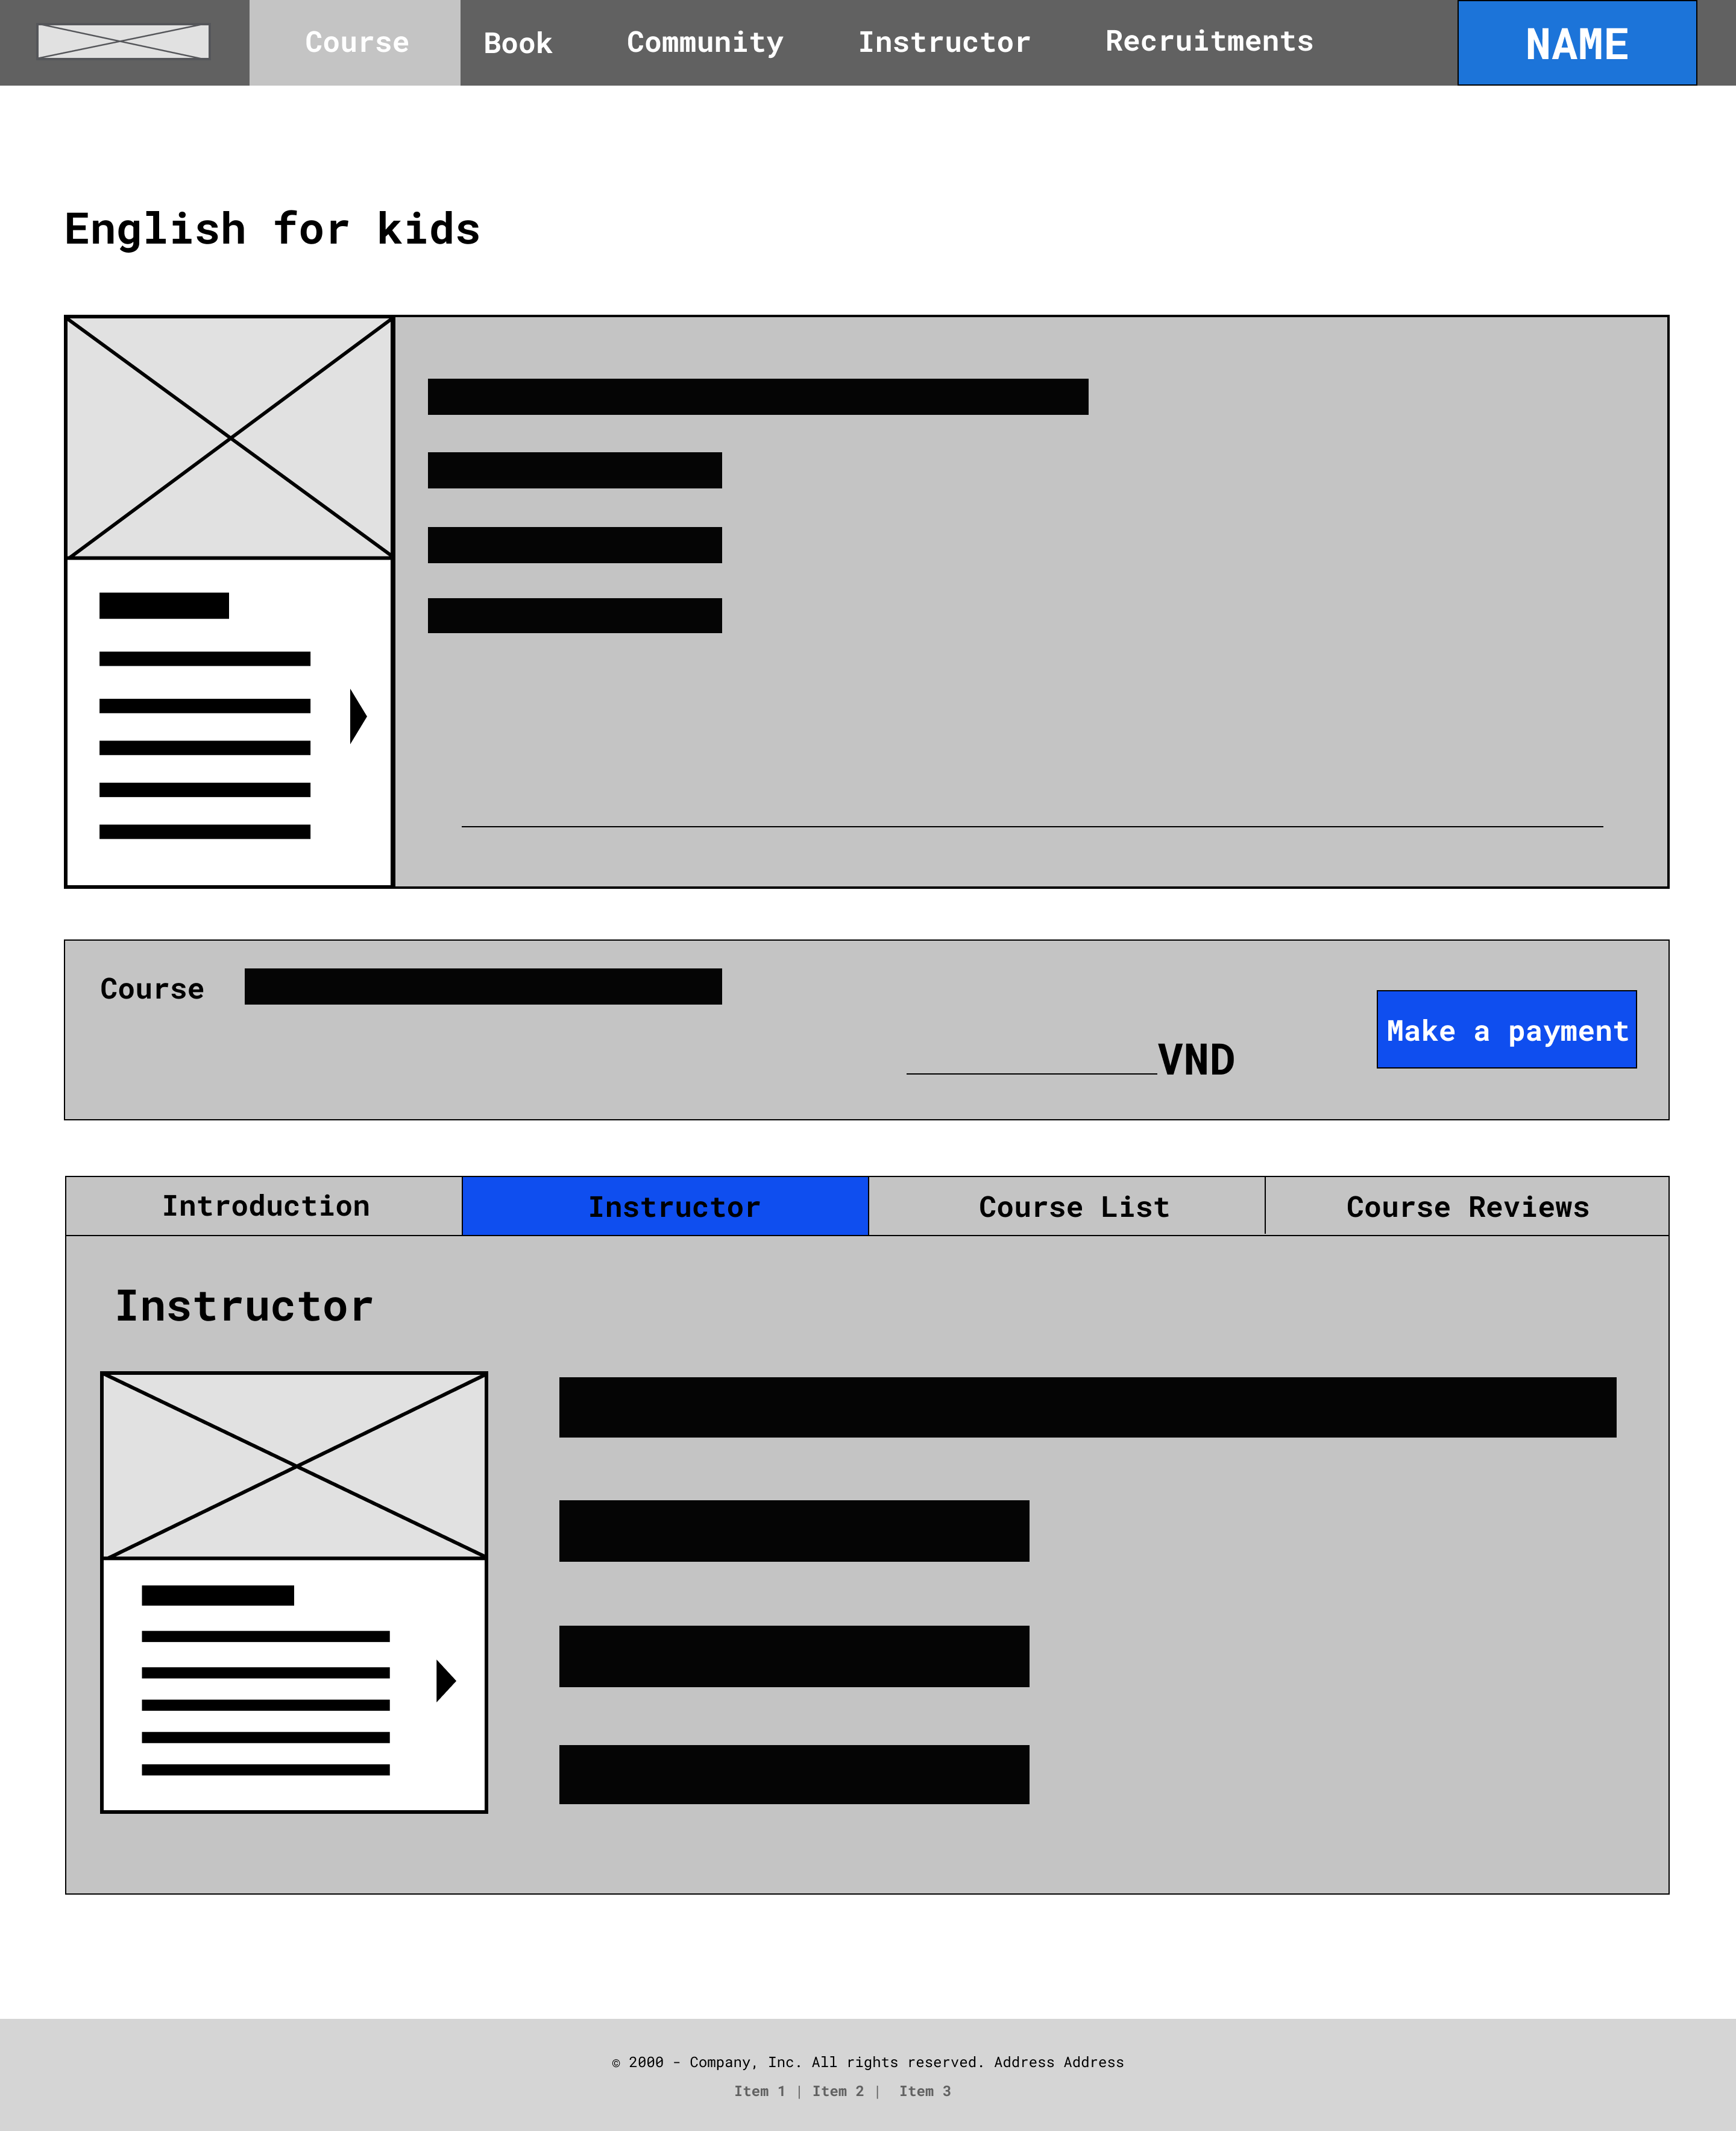
Number | Description
1 | When click tab → show detail instructor of courses
2 | Image of the instructor
3 | Detail instructor information
Detail Course – Information (Instructor)
1
2
3

Slide 48
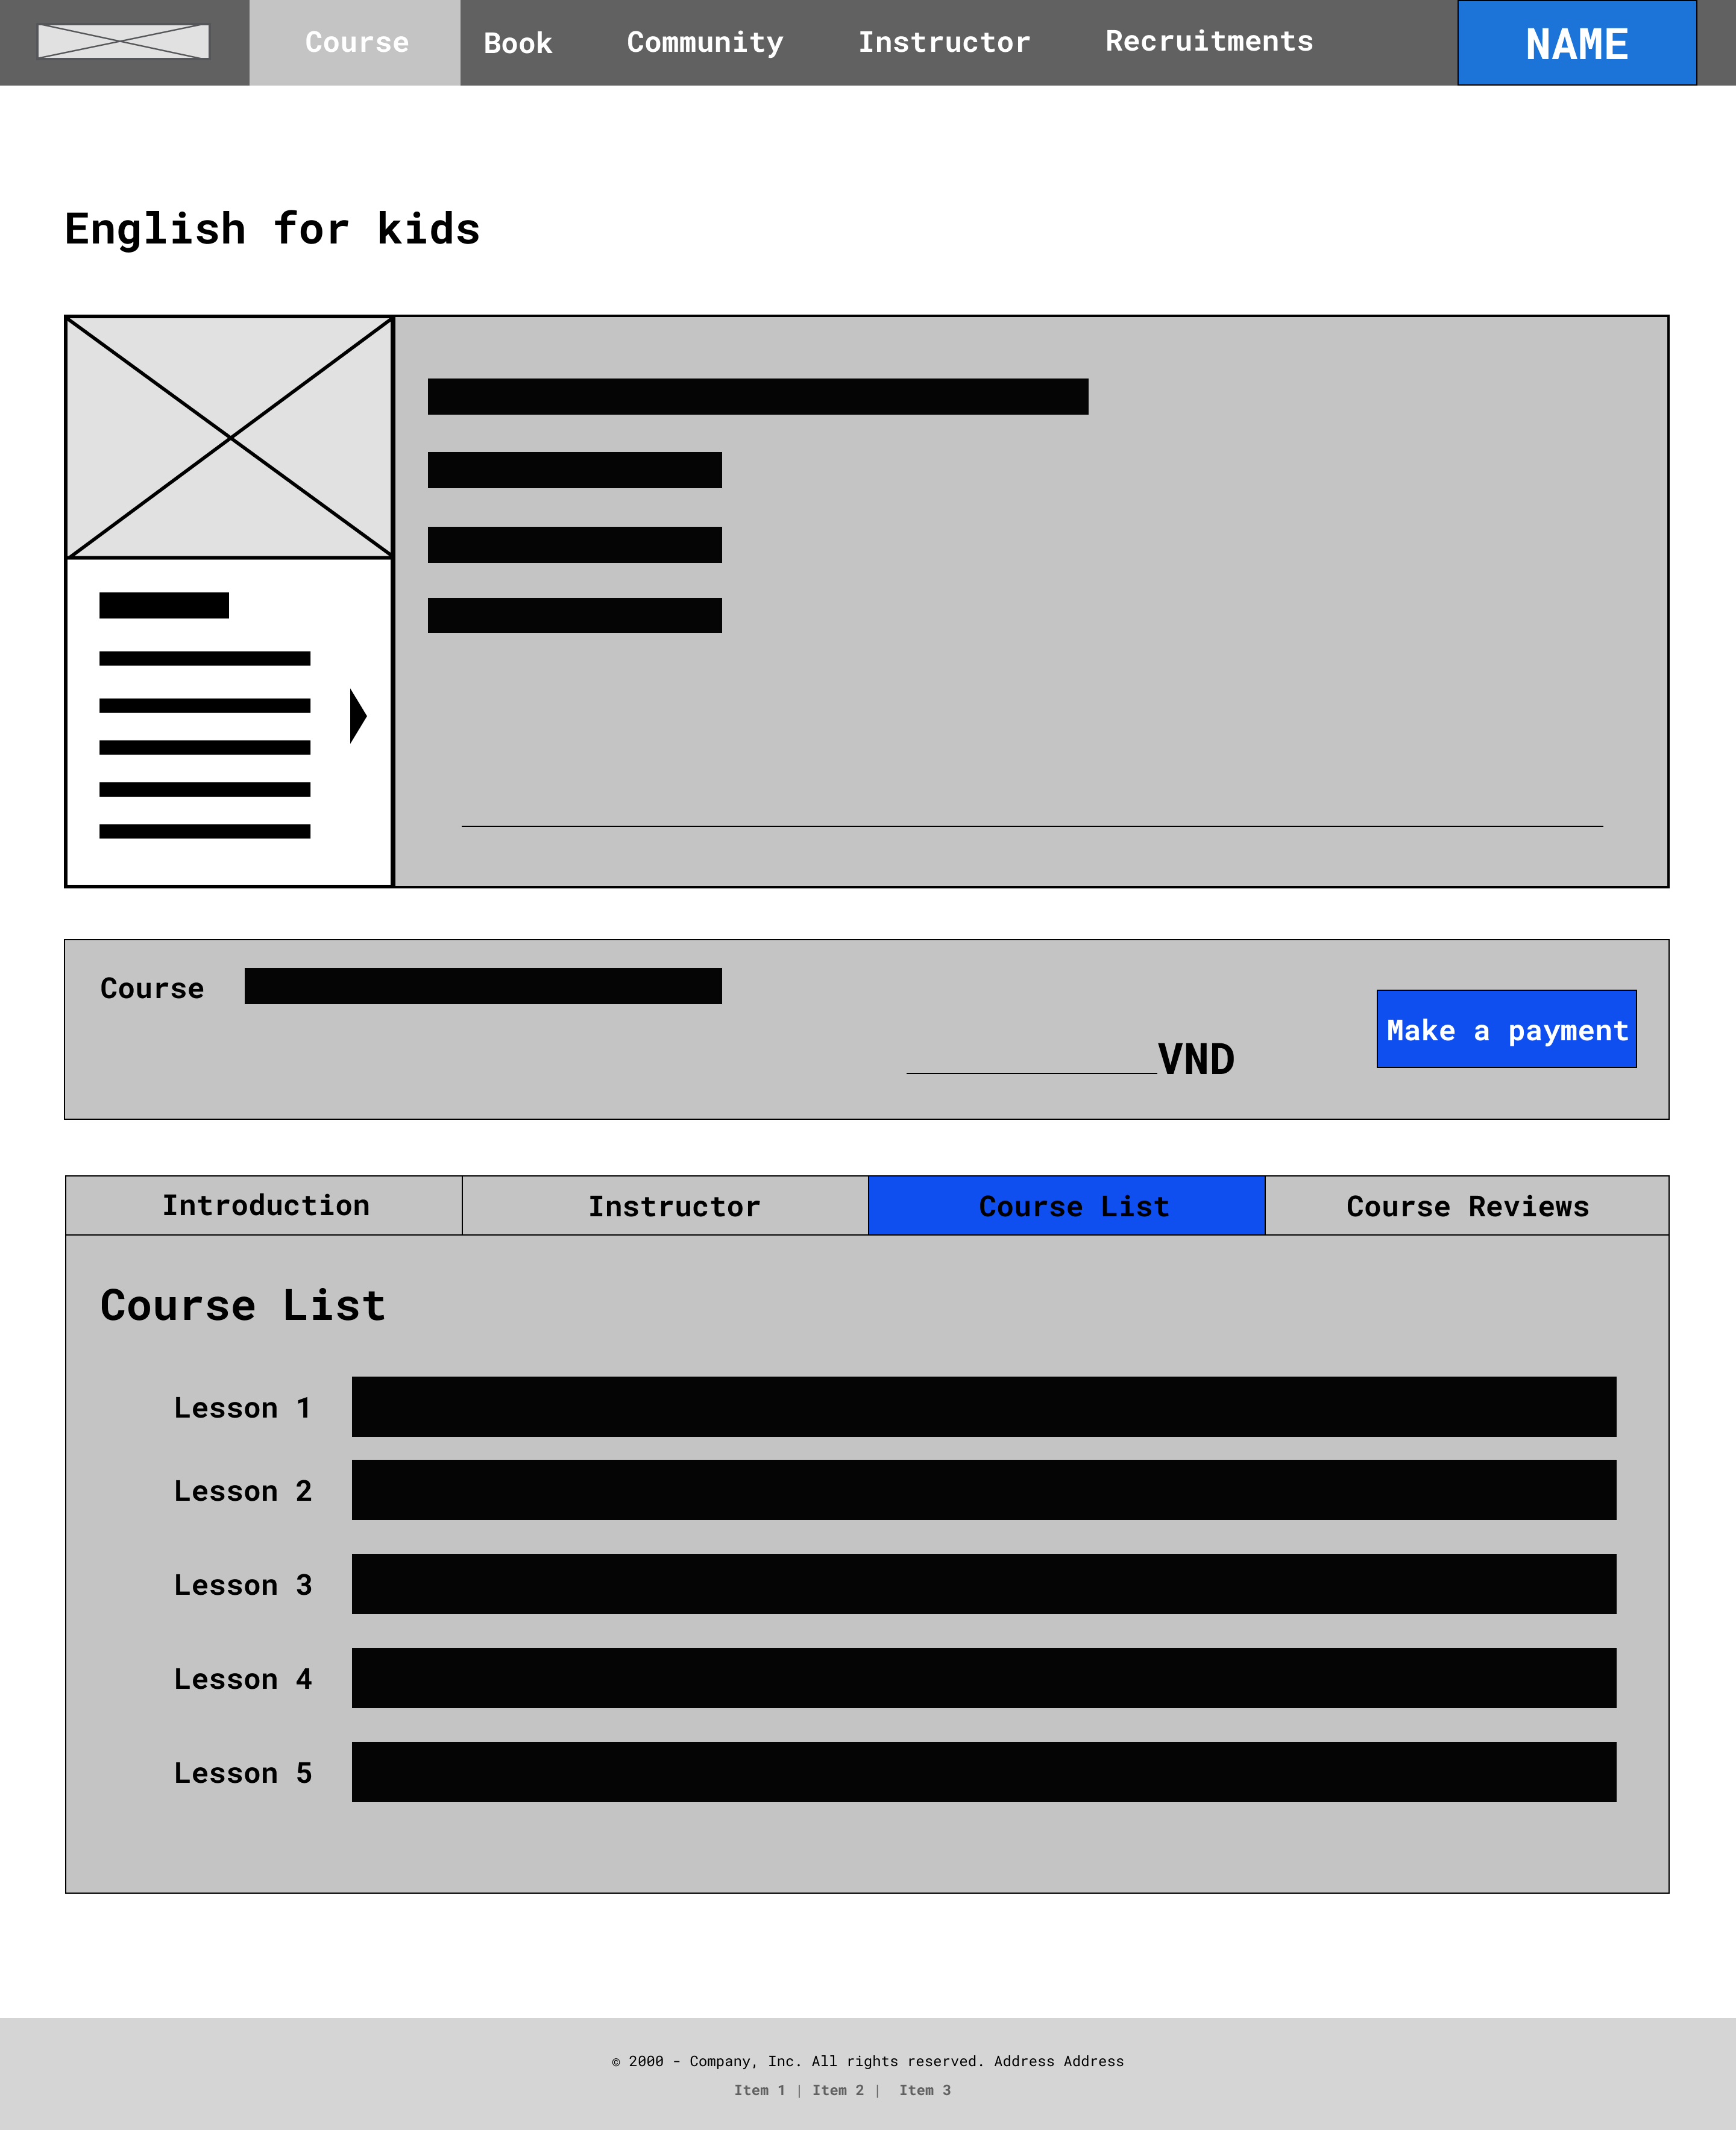
Number | Description
1 | When click tab → show detail course
2 | Show all lessons list
Detail Course – Information (Course List)
1
2

Slide 49
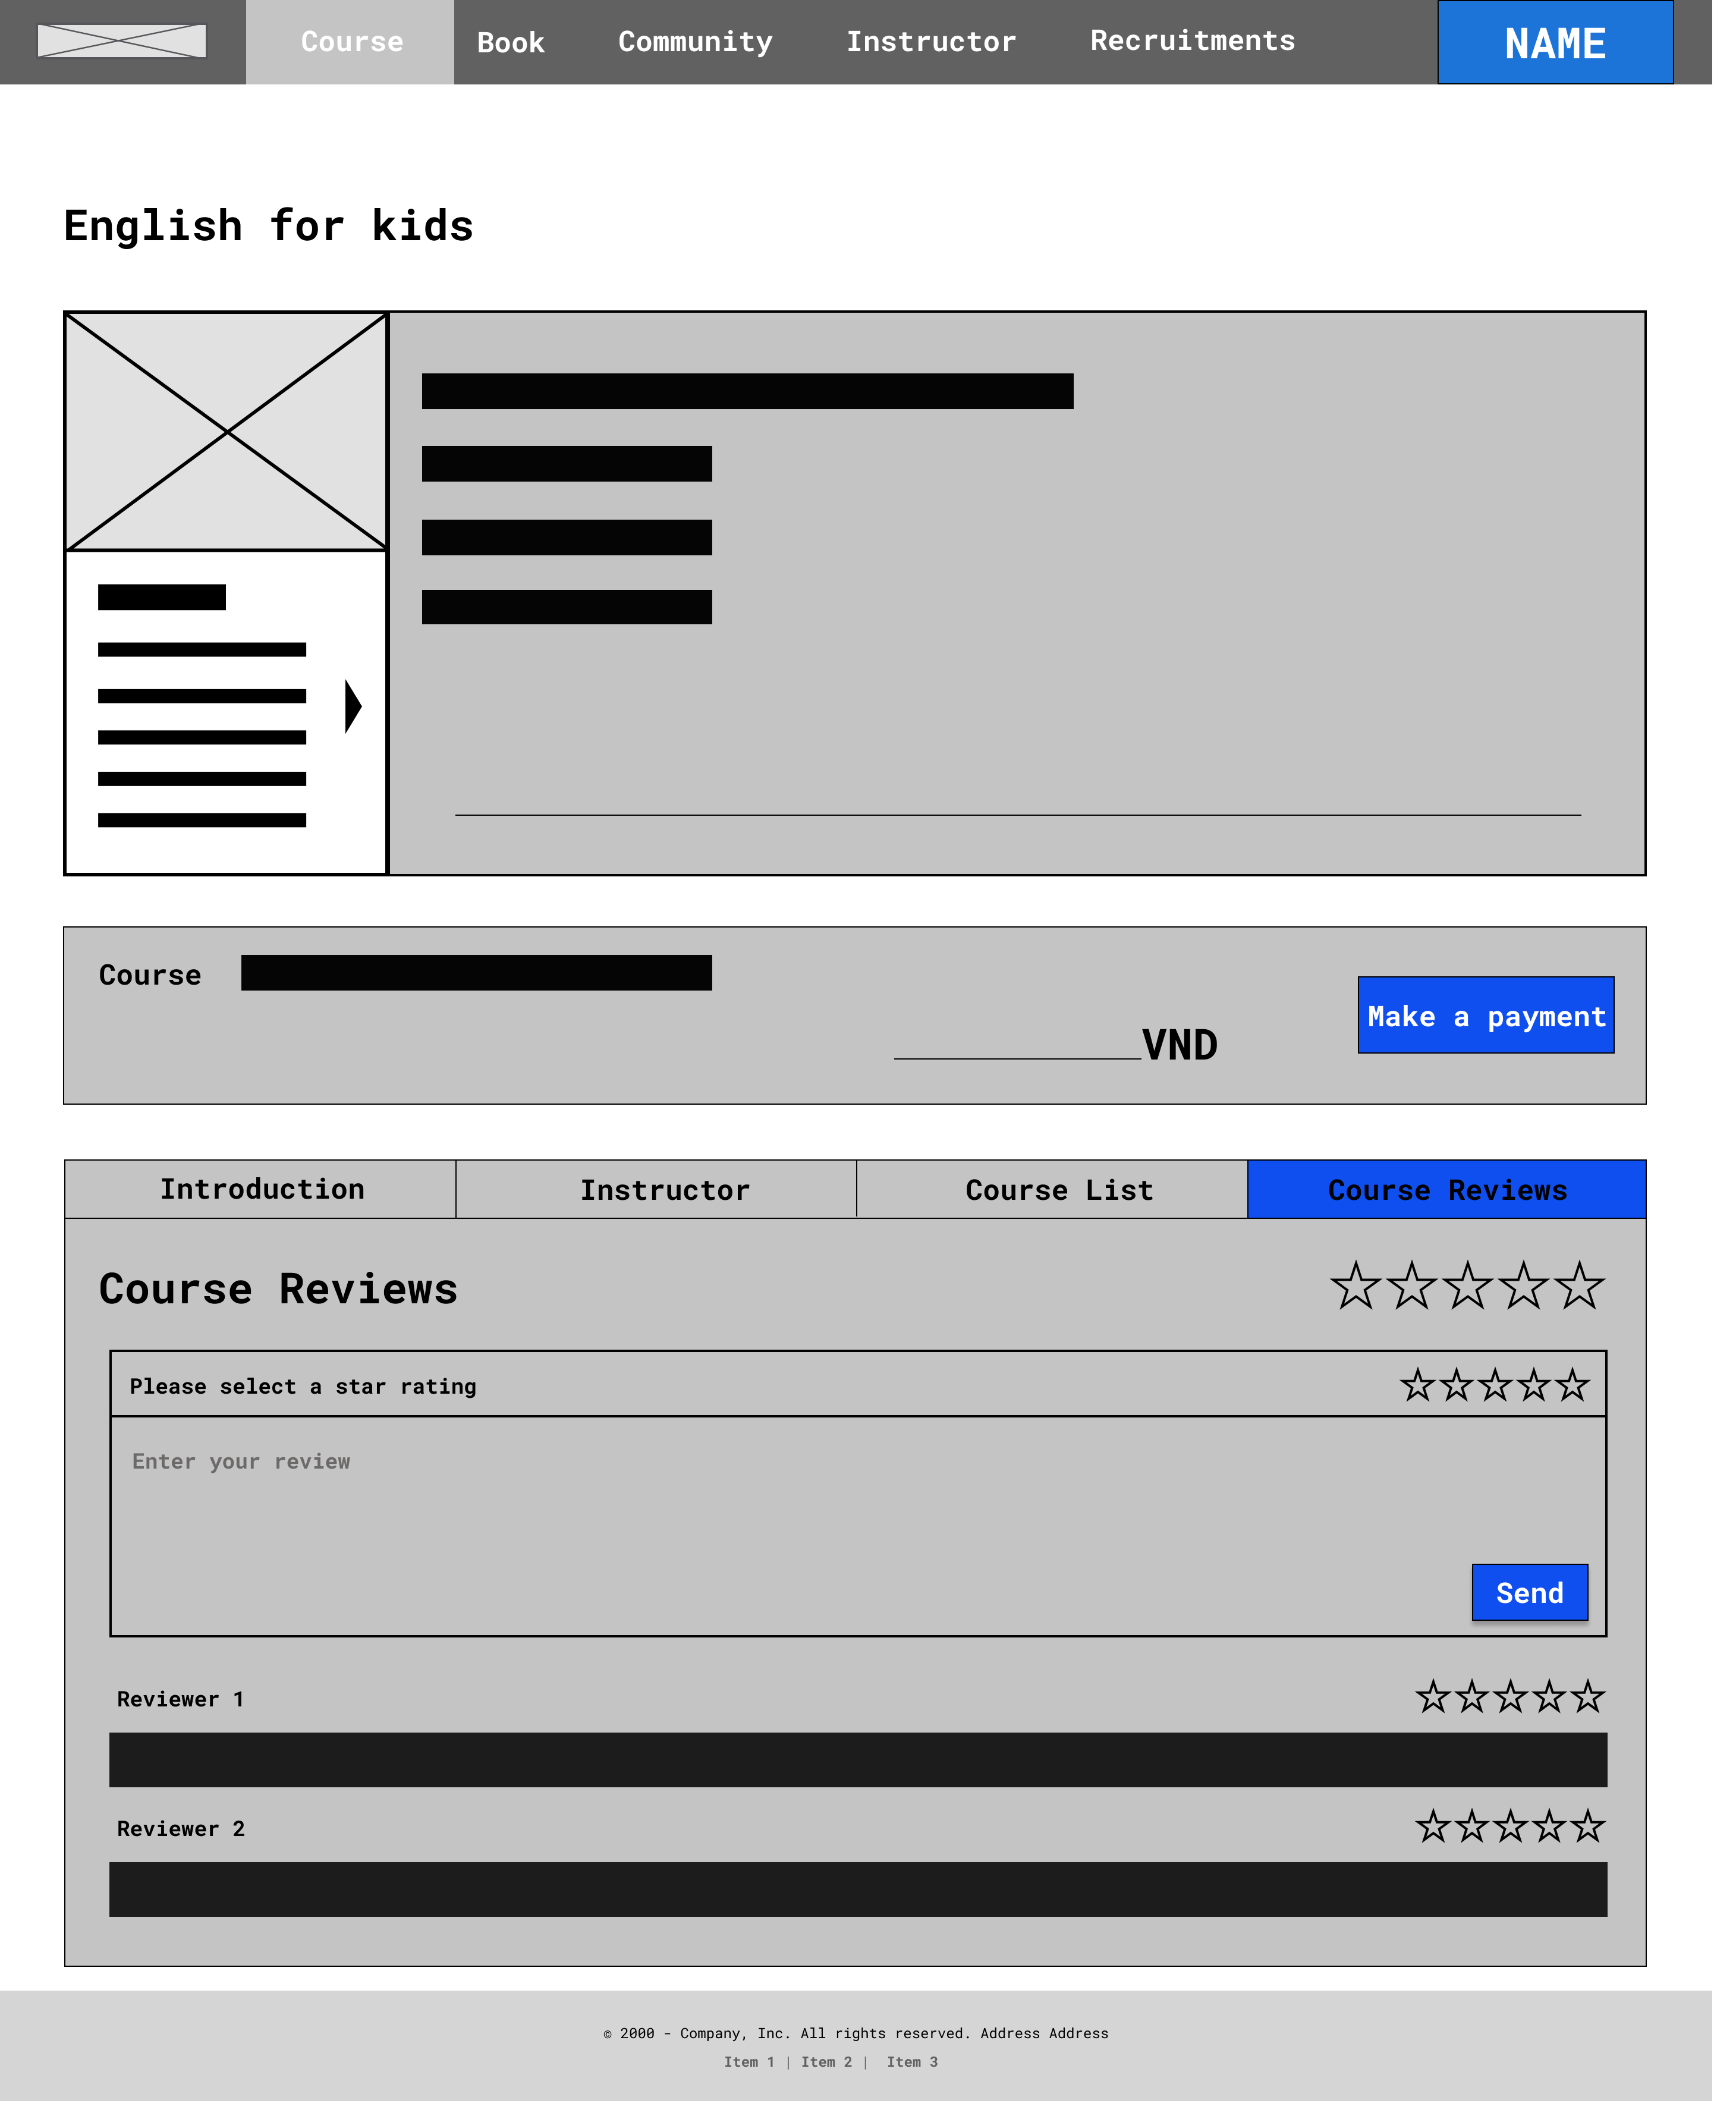
Number | Description
1 | When click tab → show detail instructor of courses
2 | Image of the instructor
3 | Detail instructor information
Detail Course – Information (Course Reviews)
1
2
3
4
5

Slide 50
Story board:
Register course
Student

Slide 51
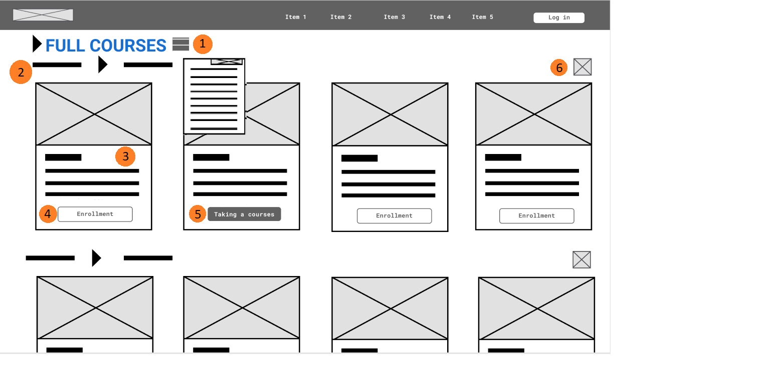
Number | Description
1 | Show the items of other courses
2 | Back to Home Page
3 | Main information of course: name teacher, number of lectures, number of lectures
4 | Button “Enrollment” -> Go to details page
5 | Button “Taking a courses” -> Go to class page
6 | Button “+” -> Go to different course of each categories
Frame shows courses

Slide 52
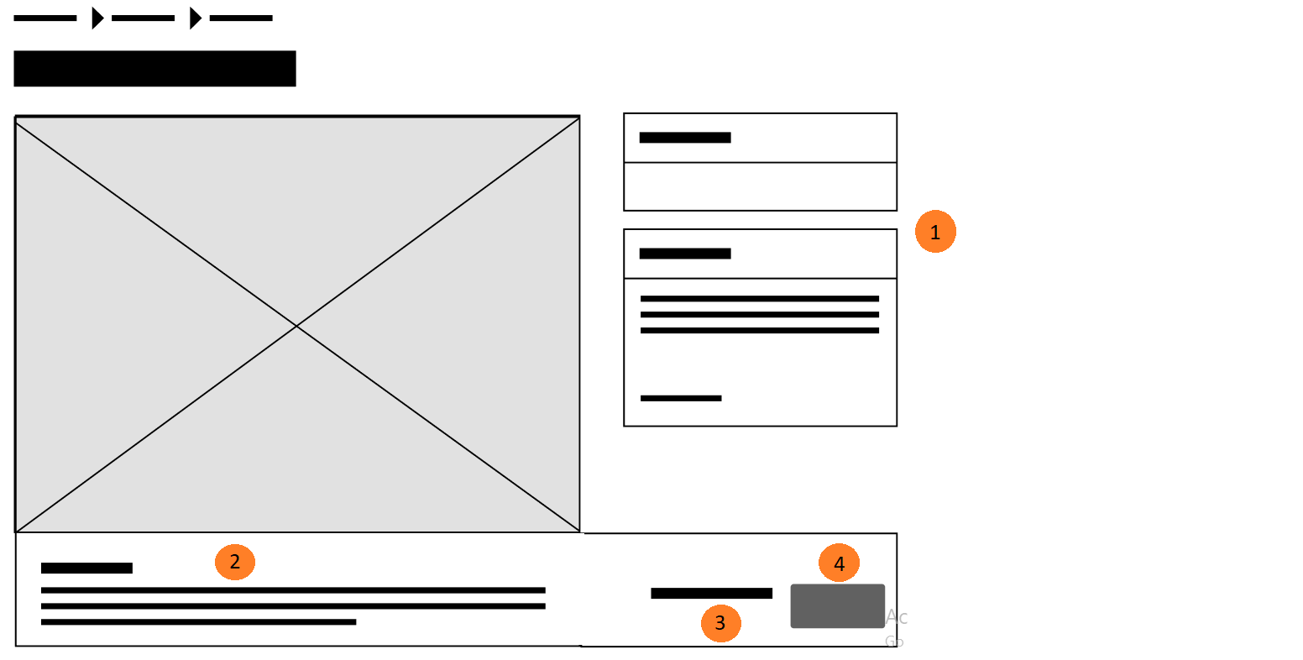
Number | Description
1 | Detail information of course
2 | Special requirements
3 | Price
4 | Button “Payment” -> Open box Payment
Detail Page (when click button “Enrollment”)

Slide 53
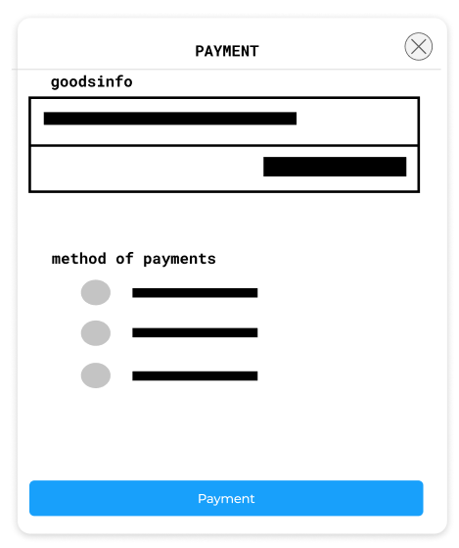
Number | Description
1 | Title product
2 | Price of product
3 | Methods of payments: Momo, banking,…
4 | Methods of payments: Deposit -> Student can go bank to transfer
5 | Button “Payment” -> Send info payment, Open new window “Online banking”
6 | Close box Payment
Box Payment when click button “Payment” in Detail Page
6
1
2
3
4
5

Slide 54
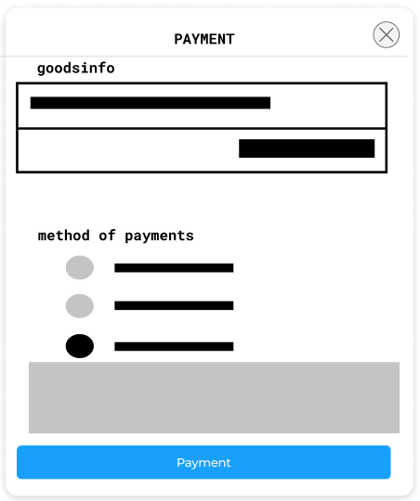
Number | Description
1 | Information: + Bank information + Expire date + Some terms
2 | Button “Payment” -> Go to box “Payment Application” (no open “Online banking” window)
When select method: “Deposit”
Deposit
1
2

Slide 55
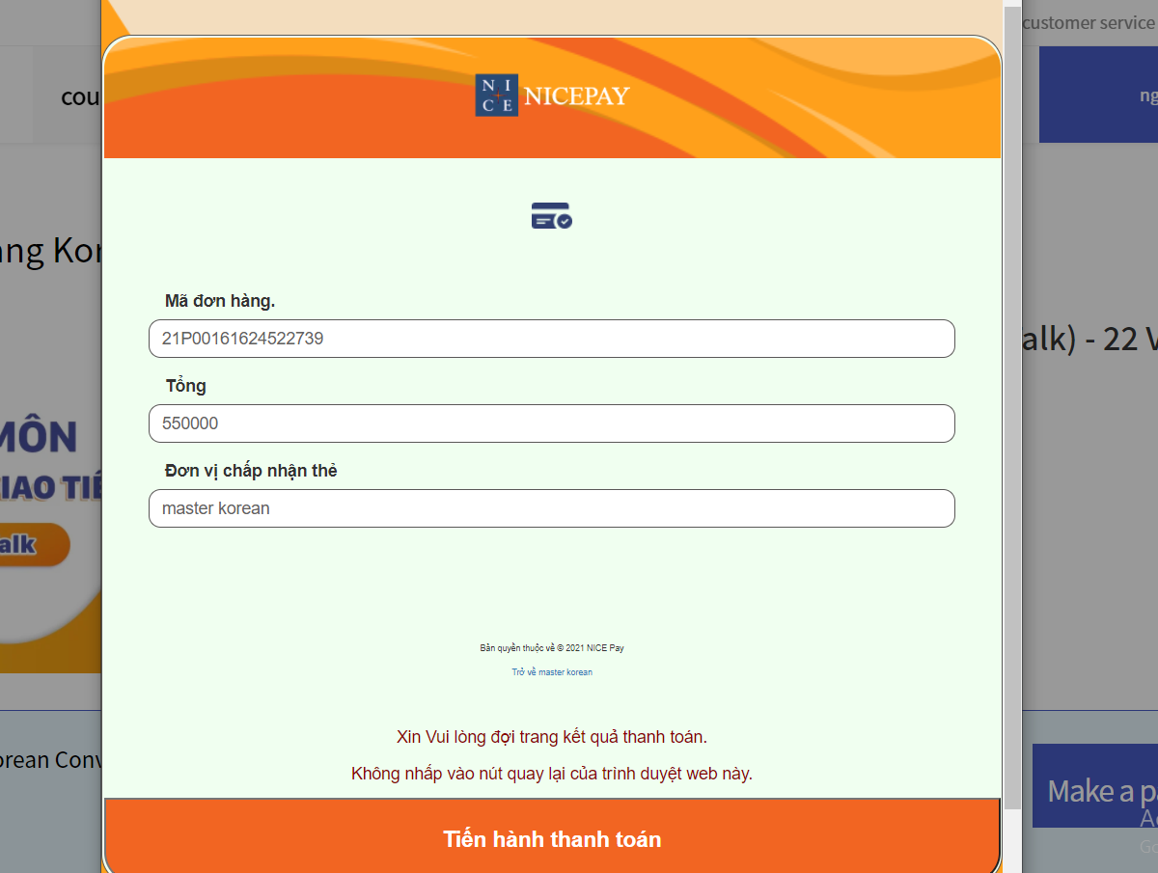
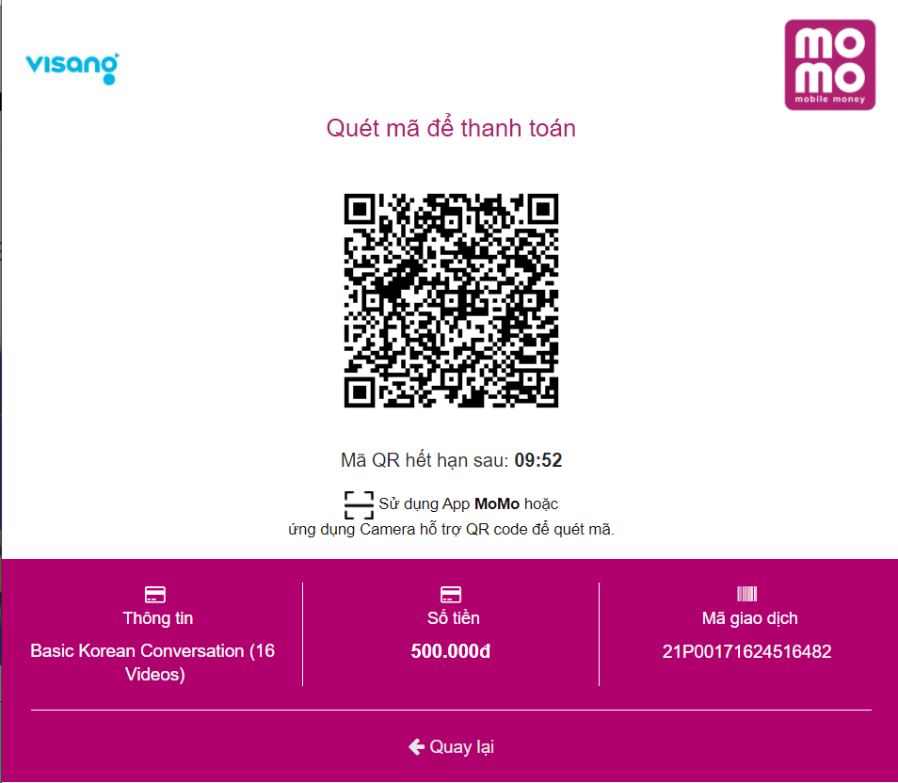
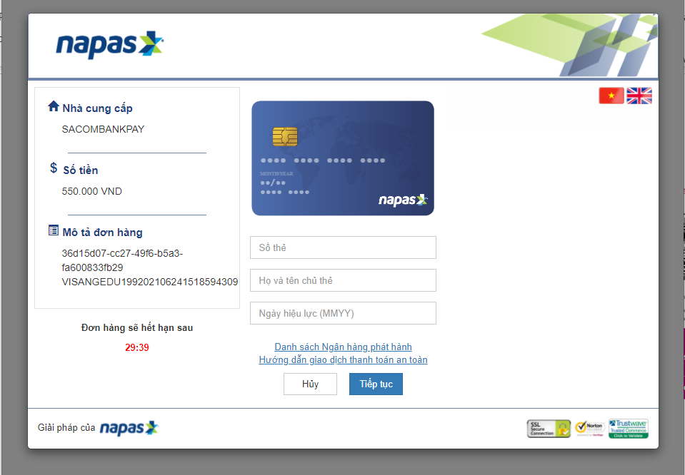
Example some online banking

Slide 56
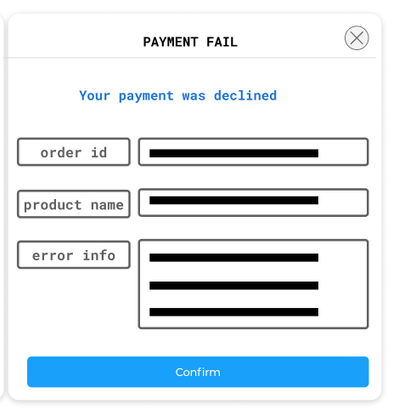
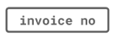
Number | Description
1 | Invoice no
2 | Product name
3 | Error information <- from online banking response
4 | Button “Confirm” -> Cancel transaction -> Go back to Detail Page
Click button “Payment” when fail
1
2
3
4

Slide 57
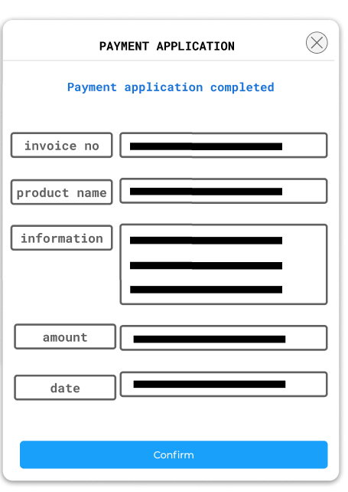
Number | Description
1 | Invoice no
2 | Product name
3 | Information: Bank: payment info Deposit: terms info
4 | Amount of payment (student)
5 | Approval date Bank: current date Deposit: map to expire date in terms
6 | Button “Confirm” -> Go back Detail Page change statuses.
Click button “Payment” when success
1
2
3
4
5
6

Slide 58
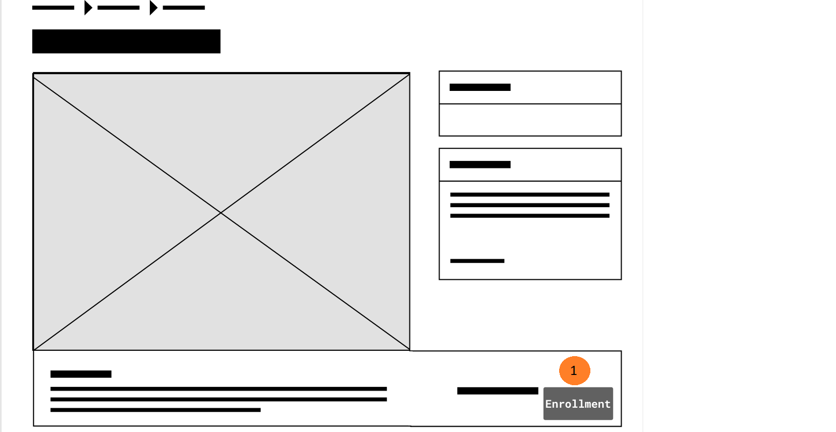
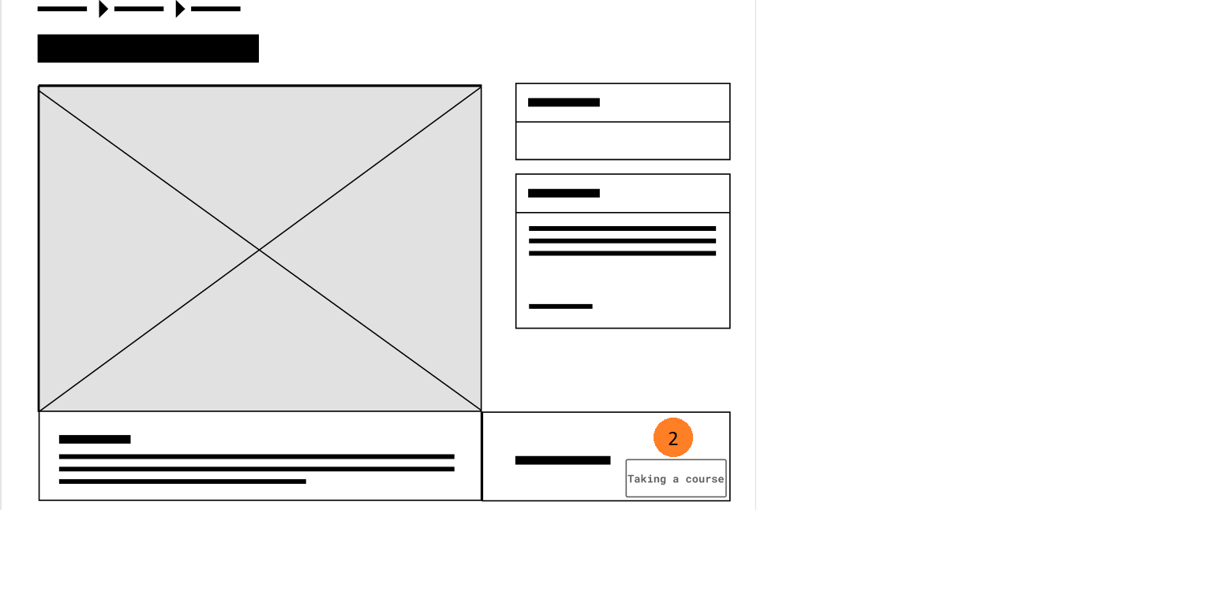
Number | Description
1 | Button “Enrollment” when unregistered
2 | Button “Taking a course” when registered
Change status to “Taking a course”

Slide 59
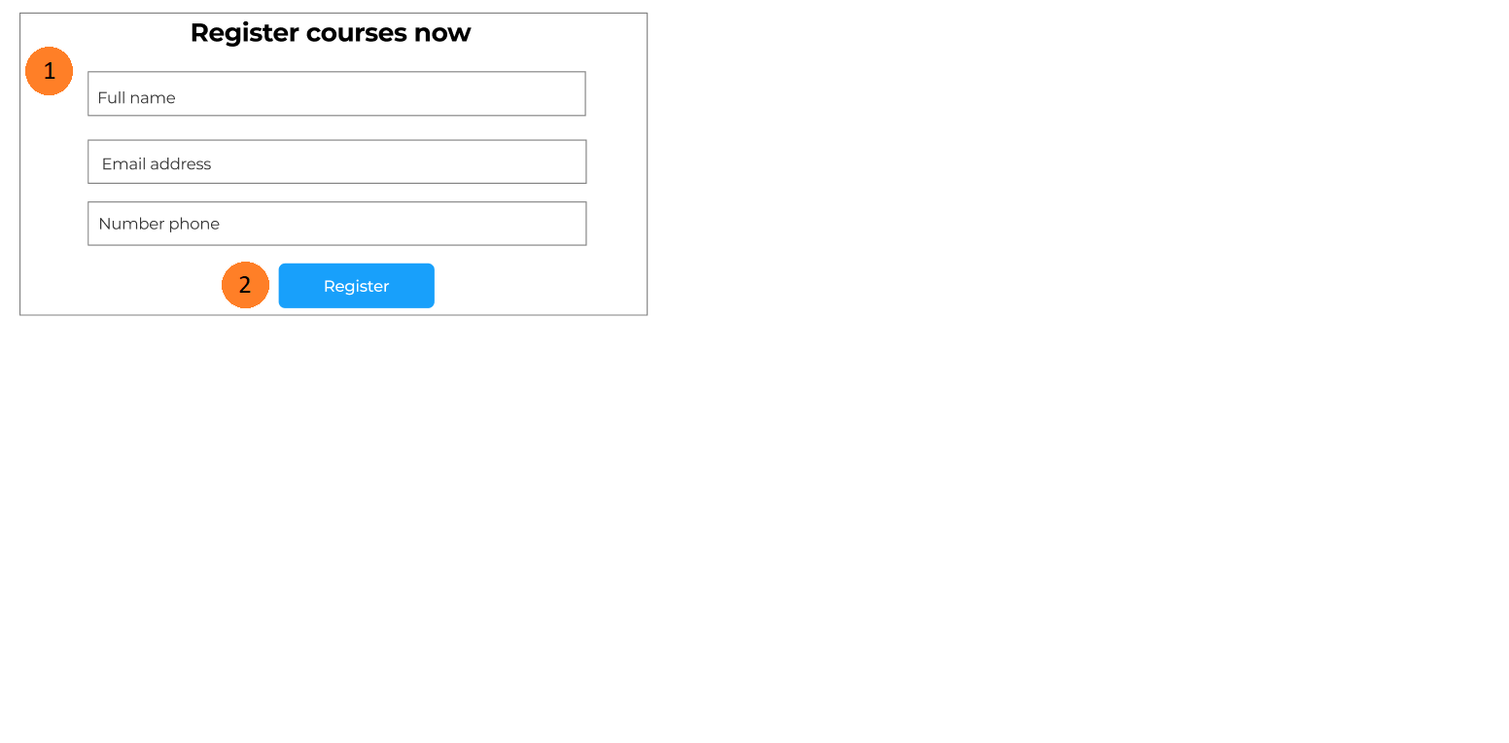
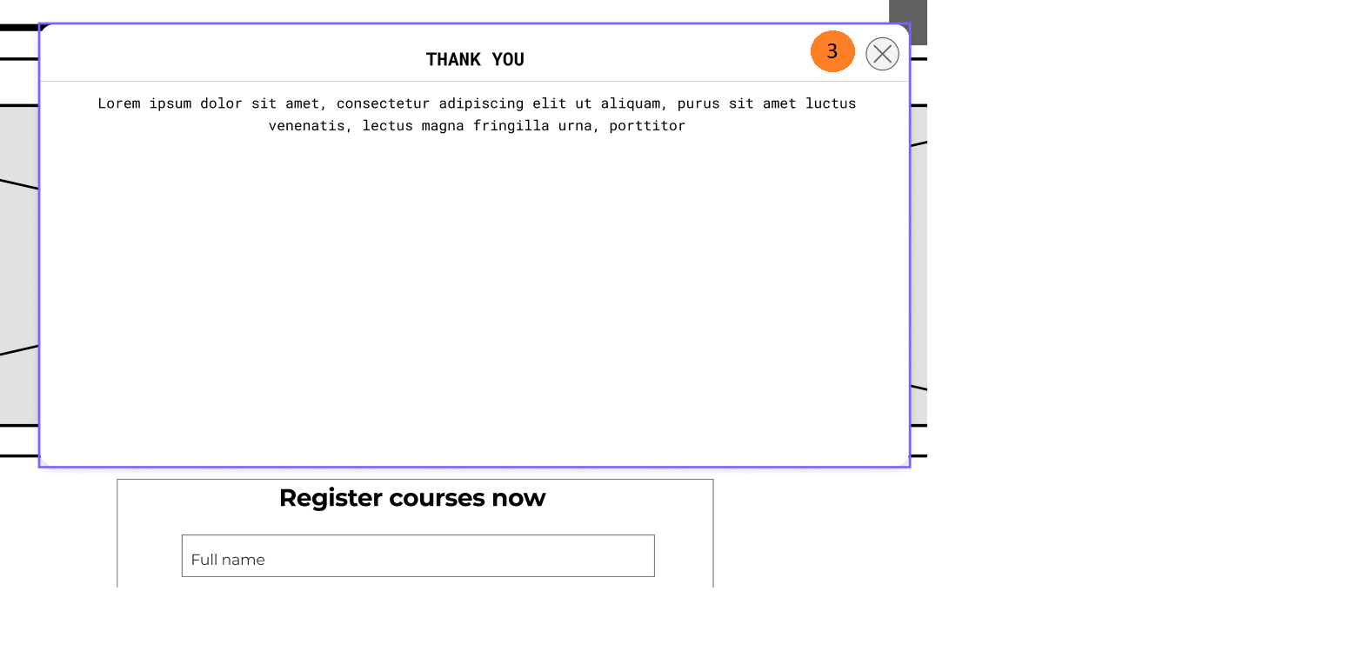
Number | Description
1 | Enter the information (check true each input)
2 | Button “Register” -> Send the information to Admin for review, then open box “Thank you”
3 | Button “X” -> Turn off box “Thank you”
Scroll down this page – See “Quick registration section”

Slide 60
Student
Story board:
Course Registered

Slide 61
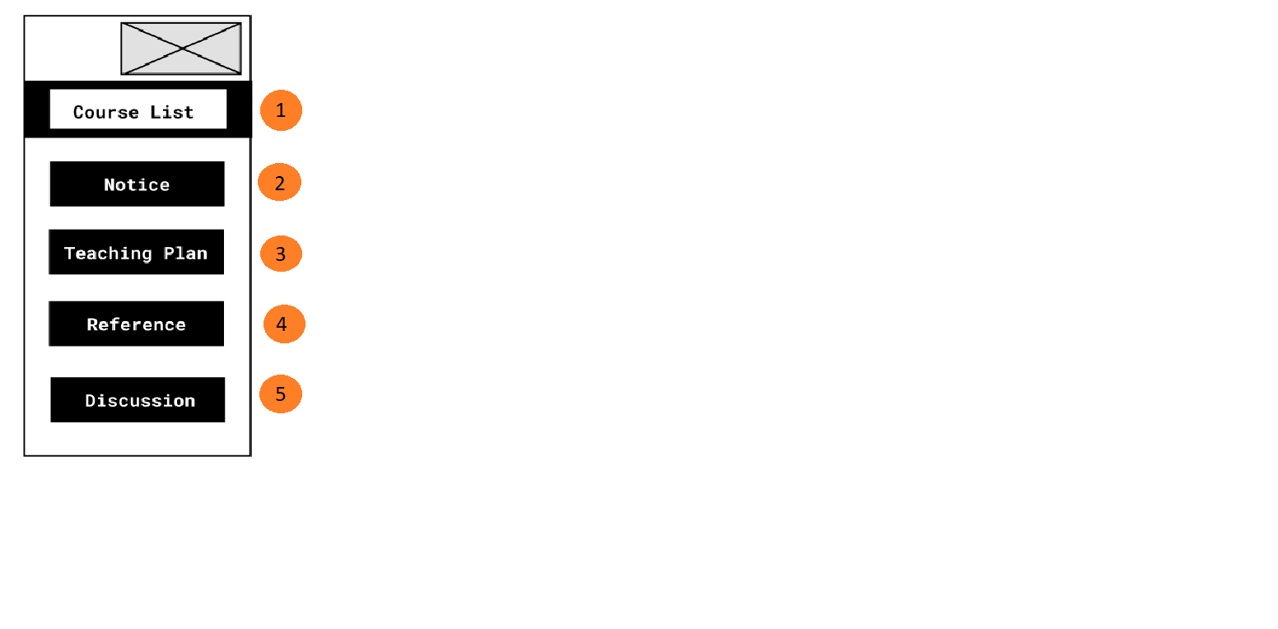
Number | Description
1 | List of course
2 | notice for student
3 | Teaching plane of student
4 | reference
. Taskbar of Course Page
5 | Student can discussion

Slide 62

Number | Description
1 | When click tab “course list” show all lesson information
2 | Show the name’s course
3 | Button “current learning” → show the current lesson
4 | Show the percentage process
5 | Show name lesson
6 | Show detail lesson → when click show the video lesson
1
2
3
4
5
6

Slide 63


. Watch lesson video

Slide 64

Number | Description
1 | Course notice
2 | Content search
3 | Combobox Writer, Content,…
4 | Button “Search”
. Course notice
5 | Show searching information in here

Slide 65

Number | Description
1 | When click tab “course review” → show the form feedback
2 | Show name’s course
3 | Click to select star rating
4 | Input feedback
5 | Button “SEND” to submit feedback to admin
2
1
3
4
5

Slide 66
Story board:
Course of Instructor
Instructor

Slide 67

Number | Description
1 | If teacher want to add a new book .Redirect to form add book
2 | If teacher want to add a new lesson for course .Redirect to form add lesson
. Taskbar of Course Page

Slide 68

Number | Description
1 | When submit it not yet show in list book because waiting for admin check When admin accept it will shown frame show book
. Add book page

Slide 69

Number | Description
1 | When submit it not yet show in course because waiting for admin check When admin accept it will shown in course
. Add lesson page

Slide 70
Story board:
Feedback
Student
Instructor

Slide 71

Number | Description
1 | When click tab “course reviews” -- > all list feedback
2 | Show the score this course
3 | Show student’s feedback
4 | Show score’s feedback
5
6
1
2
3
4

Slide 72
Student
Story board:
Order Book

Slide 73

Number | Description
1 | Image of book ->Go to detail of book
2 | Book information
3 | When click button “Read more” -> Go to detail information of book.
Frame show books
1
3
2

Slide 74


Number | Description
1 | Image of book
2 | Book information
3 | When click button “Take a book” -> Go to make a payment.
Book Page
1
3
3
2
2

Slide 75

Number | Description
1 | Login
2 | If don’t have account, click button “Sign up” Sign up
3 | Username
4 | Password
5 | Login -> Login success go back to detail information book and display “Payment”
Book Page
1
2
1
2
Username
3
Password
4
5

Slide 76

Number | Description
1 | Check information of book: price,…
2 | Button “Payment” -> when click check again information book.
Book Page
1
2

Slide 77

Number | Description
1 | Billing information
2 | Click button ”Confirm” close
Book Page
1
2

Slide 78
Student
Story board:
View Instructor

Slide 79

Number | Description
1 | Image of instructor ->detail of instructor
2 | Information of instructor
. Instructor list page

Slide 80

Number | Description
1 | Image of instructor
2 | Information of instructor
3 | Image of course of instructor
4 | Information course
. Detail instructor page
5 | ->detail course Enrollment if student not register this course Taking a course if student registered this course

Slide 81
Student
Story board:
Recruitment

Slide 82

Recruitments Information Page
Number | Description
1 | Tab “Recruitment” → show jobs information
2 | Input name jobs, company to search
3 | Show list recommend jobs
4 | Show the occupation category group
5 | Show the jobs information according to popular , newest, deadline
6 | Show list jobs default popular
7 | Button click to show more jobs information
1
2
3
4
5
6
7

Slide 83

Recruitments Information Page
Number | Description
1 | Image and information ‘s bussiness
2 | Position information that the employer needs to recruit
3 | Button “apply now” to send CV to recruiter
4 | Show details information about this position
5 | Show list similar jobs
1
2
3
4
5

Slide 84

Recruitments Information Page
Number | Description
1 | Form “submit resume” → to upload CV
2 | Button “X” to close form
3 | Image logo and name company
4 | Button “File upload” to upload CV
5 | Button “Submit” to send CV information to recruiter
1
2
3
4
5

Slide 85
Business
Story board:
Recruitment
Story board:
Recruitment

Slide 86

Number | Description
1 | Image logo company
2 | Tab “list candidate” → show list candidate apply jobs
3 | Show candidate information
Business Account → List Candidate
1
3
2

Slide 87

Number | Description
1 | Tab “list jobs” → show list jobs are posted
2 | Show list jobs of company
3 | Button “EDIT/DELETE”
4 | Show pages of list jobs
Business Account → List Jobs
2
3
1
4

Slide 88

Number | Description
1 | Form edit jobs information
2 | Button “SAVE” → update new information
Business Account → List Jobs → Edit
1
2

Slide 89

Number | Description
1 | Tab “edit account” → to business can edit information
2 | Form edit information
3 | Button “Change Password” → update new password
4 | Button “SAVE” → post new jobs
Business Account → Edit Account
2
3
1
4

Slide 90

Number | Description
1 | Form change password business account
2 | Button “X” → cancel change password
3 | Button “CHANGE PASSWORD” → to update new password
Business Account → Edit Account → Change password
2
1
3

Slide 91
Student
Story board:
Chat box
Business
Instructor
Admin

Slide 92


Number | Description
1 | Popup icon fb
2 | Chat with admin
.Facebook chatbot
1
2
1
1

Slide 93
Admin
Story board:
Admin Page

Slide 94

Number | Description
1 | logo
2 | Search student, course, instructor
3 | Image of admin ,when click have logout, profile admin, change password
4 | Total student
. Home admin page
2
3
1
4
5
6
7
8
9
4 | Total course
5 | Total instructor
6 | Total student
7 | List of instructor
8 | List of student
9 | List Salary status of instructor

Slide 95


6 | When click redirect to List Book and List lession
7 | When click redirect to List of all checkbook page
8 | When click redirect to List of all check lesson page
9 | When click redirect to List of all list lesson page
10 | When click redirect to List of category page
Number | Description
1 | When click redirect to List of all instructor page
2 | When click redirect to List of all student page
3 | When click redirect to List of all course page
4 | When click redirect to List of payment page
1
2
3
4
5
6
7
8
9
10
11
5 | When click redirect to List of all jobs

Slide 96

Number | Description
1 | Show 5-10-15 instructor
2 | Search name instructor
3 | Add a new instructor
4 | Update instructor
. All instructor page
5 | Delete instructor
6 | Pagination

Slide 97

.Add instructor page
Number | Description
1 | When click popup date appear
2 | File image
3 | Redirect to list instructor

Slide 98

Number | Description
1 | Image of instructor
2 | First name
3 | Last name
4 | Phone number
9 | Delete instructor and redirect to list instructor
10 | List course of instructor have
11 | Redirect to course detail page
. Instructor detail page
5 | Email
6 | address
8 | Redirect to edit instructor form page

Slide 99

. Edit instructor page
Number | Description
1 | Information of instructor will appear on input
3 | Redirect to list instructor

Slide 100

Number | Description
1 | Show 5-10-15 student
2 | Search name student
3 | Add a new student
4 | Update student
. List student page
5 | Delete student
6 | Pagination

Slide 101

Number | Description
1 | When click popup date appear
2 | File image
. Add student page
3 | Redirect to list student

Slide 102

Number | Description
1 | Image of student
2 | First name
3 | Last name
4 | Phone number
9 | Delete student and redirect to list instructor
10 | List course of student have
11 | Redirect to course detail page
. Student detail page
5 | Email
6 | address
8 | Redirect to edit student page

Slide 103

. Edit student page
Number | Description
1 | Information of student will appear on input
3 | Redirect to list student

Slide 104

Number | Description
1 | Name of course
2 | Information of course
. All course page
3 | Redirect to detail course
4 | Redirect to add new course page

Slide 105

Number | Description
1 | List of teacher will appear
2 | List of category course will appear
. Add course page
3 | Choose image course
4 | Redirect to list all course

Slide 106

Number | Description
1 | Image of course
2 | Teacher of course
3 | Category of course
4 | Price of course
. Detail course page
5 | Redirec to edit course page
6 | Lesson of course
7 | Delete course Redirect to list all course

Slide 107

Number | Description
1 | List of teacher will appear
2 | List of category course will appear
. Edit course page
3 | Choose image course
4 | Redirect to detail course

Slide 108

Number | Description
1 | Edit book redirect edit book page
2 | Delete book
. List book page
3 | Teacher save book ,if admin not yet accept it show not check, and click it redirect to checkbook page .If admin accept it show checked ,it cannot click

Slide 109

. Edit book page
Number | Description
1 | Information of book will appear on input
3 | Redirect to list book page

Slide 110

Number | Description
1 | If admin accept book ,it will delete book and save database ,and it will show list book page
2 | Not accept this book and it will be delete in this page and it will be delete in list book page
. Check book page
3 | This page will be show all Book with status not yet check

Slide 111

Number | Description
1 | Edit lesson
2 | Delete lesson
. List lesson page
3 | Teacher save lesson ,if admin not yet accept it show not check, and click it redirect to check lesson page .If admin accept it show checked ,it cannot click

Slide 112

.Edit lesson page
Number | Description
1 | Information of lesson will appear on input
3 | Redirect to list lesson page

Slide 113

Number | Description
1 | If admin accept lesson ,it will delete book and save database ,and it will show list lesson page
2 | Not accept this lesson and it will be delete in this page and it will be delete in list lesson page
. Check lesson page
3 | This page will be show all lesson with status not yet check

Slide 114

Number | Description
1 | Edit category
2 | Delete category
. Category page

Slide 115

Number | Description
1 | Table show list bussiness
2 | Button “+add company” → to create new company
3 | Button “EDIT”/”DELETE” company
List Business
1
2
3

Slide 116

Number | Description
1 | Form create account and add company information
2 | Button “UPLOAD” → to upload logo image of company
3 | Button “SUBMIT” → create new company
Form add new business
1
2
3

Slide 117

Number | Description
1 | Form edit company information
2 | Button “Change Password” → update new password
3 | Button “UPLOAD” → to upload logo image of company
4 | Button “SUBMIT” → update new information
Edit business information
1
2
3
4

Slide 118

Number | Description
1 | Form change password business account
2 | Button “X” → cancel change password
3 | Button “CHANGE PASSWORD” → to update new password
Change password business account
2
1
3
4

Slide 119

. Delete box to all

Slide 120
Review

Slide 121
Thank you
감사합니다

